Slide 1
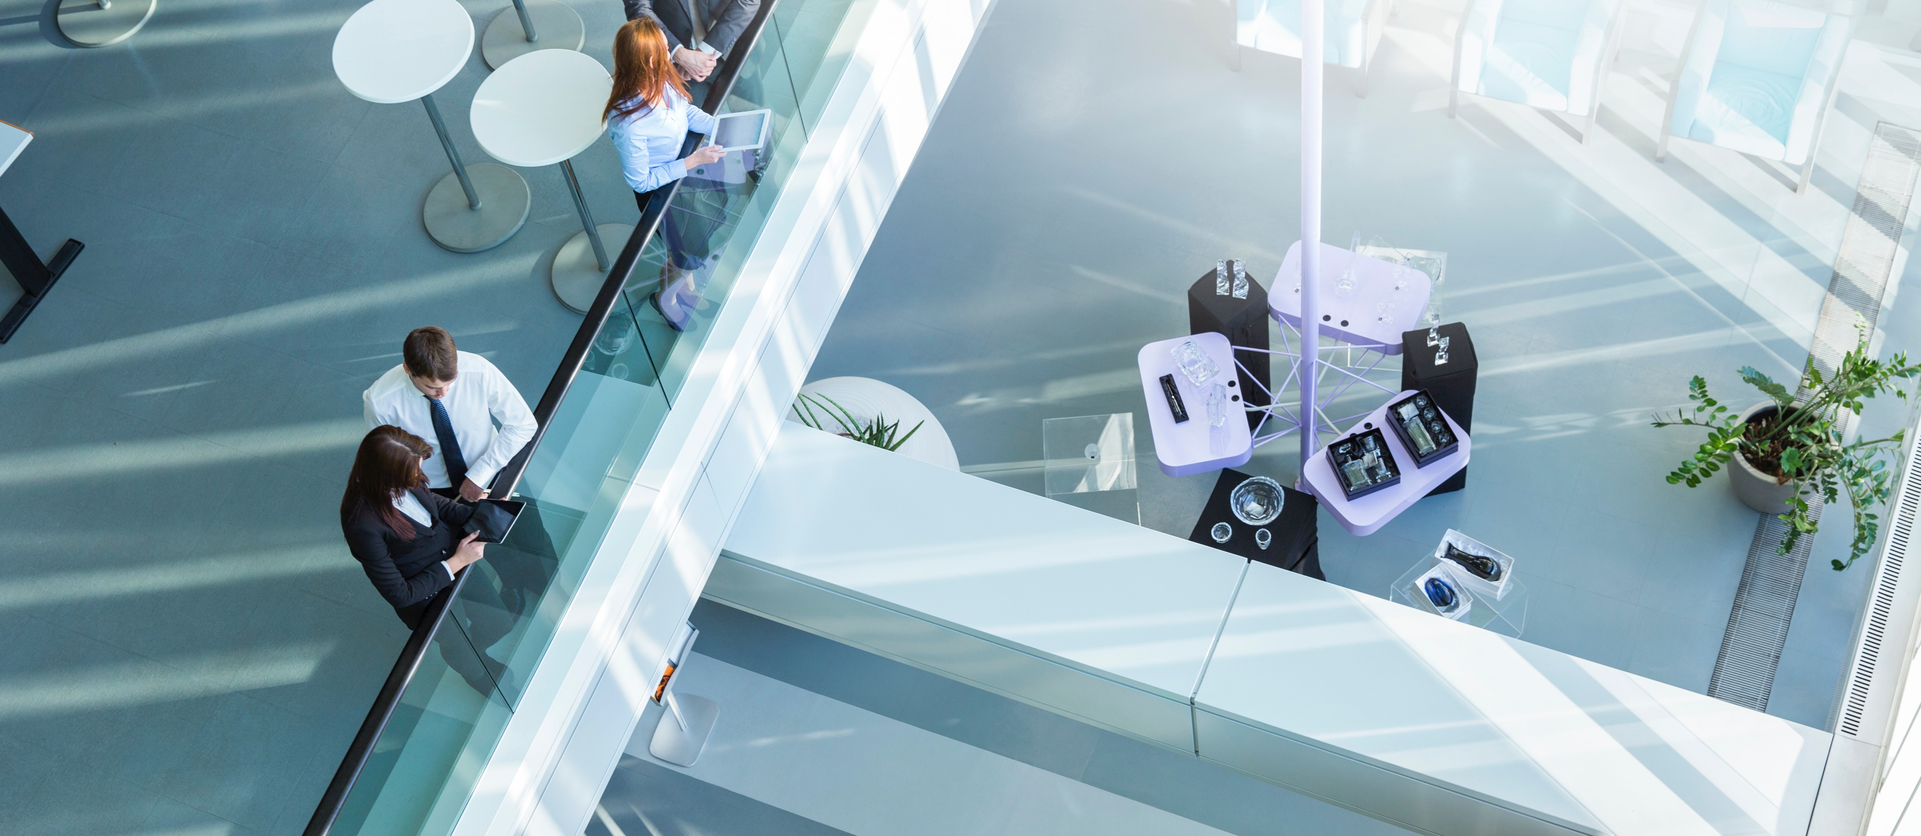
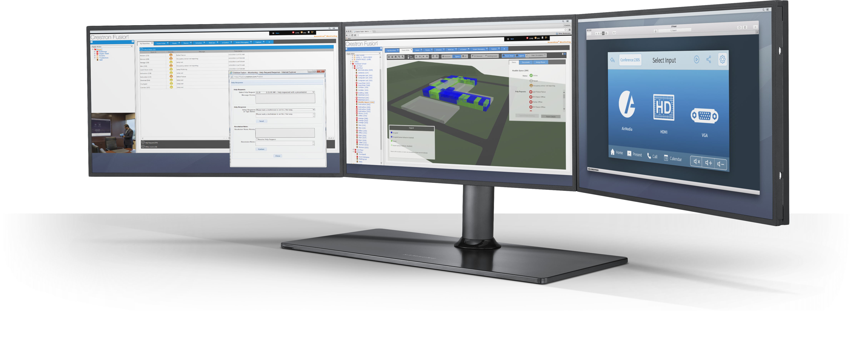
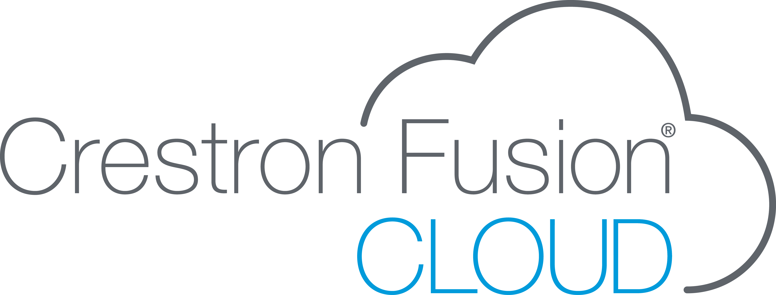
Technology that Works the Way You Work

Slide 2
Crestron Fusion® Cloud provides the information you need to
optimize your biggest investments: people, spaces, and technology.
Technology that Works the Way You Work

Slide 3




People
By helping employees locate workspaces, and easily connect to the people and tools they need, Crestron Fusion Cloud reduces the wasted time and frustration they experience throughout their day.

Slide 4

Spaces
Crestron Fusion Cloud helps real estate and facilities managers maximize room usage, and make data-driven decisions about workspace utilization and energy consumption.

Slide 5

Technology
Crestron Fusion Cloud enables IT managers to provide
real-time remote support and to gather data on
the technology people are using to maximize uptime.

Slide 6
$37B
Lost annually to poor meetings
U.S. Bureau of Labor Statistics
Notes:
Organizations constantly struggle with how to enable employees to be as successful as possible – but how?
The answer is actually simple: remove all obstacles in their way
Now, there’s a solution that does exactly that
Having Crestron Fusion® enterprise management technology in the building and the Crestron PinPoint™ app on your smart devices is like having an assistant at your side throughout the day
Crestron clears a path for you to work smarter, faster, and more efficiently

Slide 7
$1.9M
Cost of lost work time due to meeting setup
400 Employees @ 85K/year
Microsoft® and MCI® Research
Notes:
Organizations constantly struggle with how to enable employees to be as successful as possible – but how?
The answer is actually simple: remove all obstacles in their way
Now, there’s a solution that does exactly that
Having Crestron Fusion® enterprise management technology in the building and the Crestron PinPoint™ app on your smart devices is like having an assistant at your side throughout the day
Crestron clears a path for you to work smarter, faster, and more efficiently

Slide 8


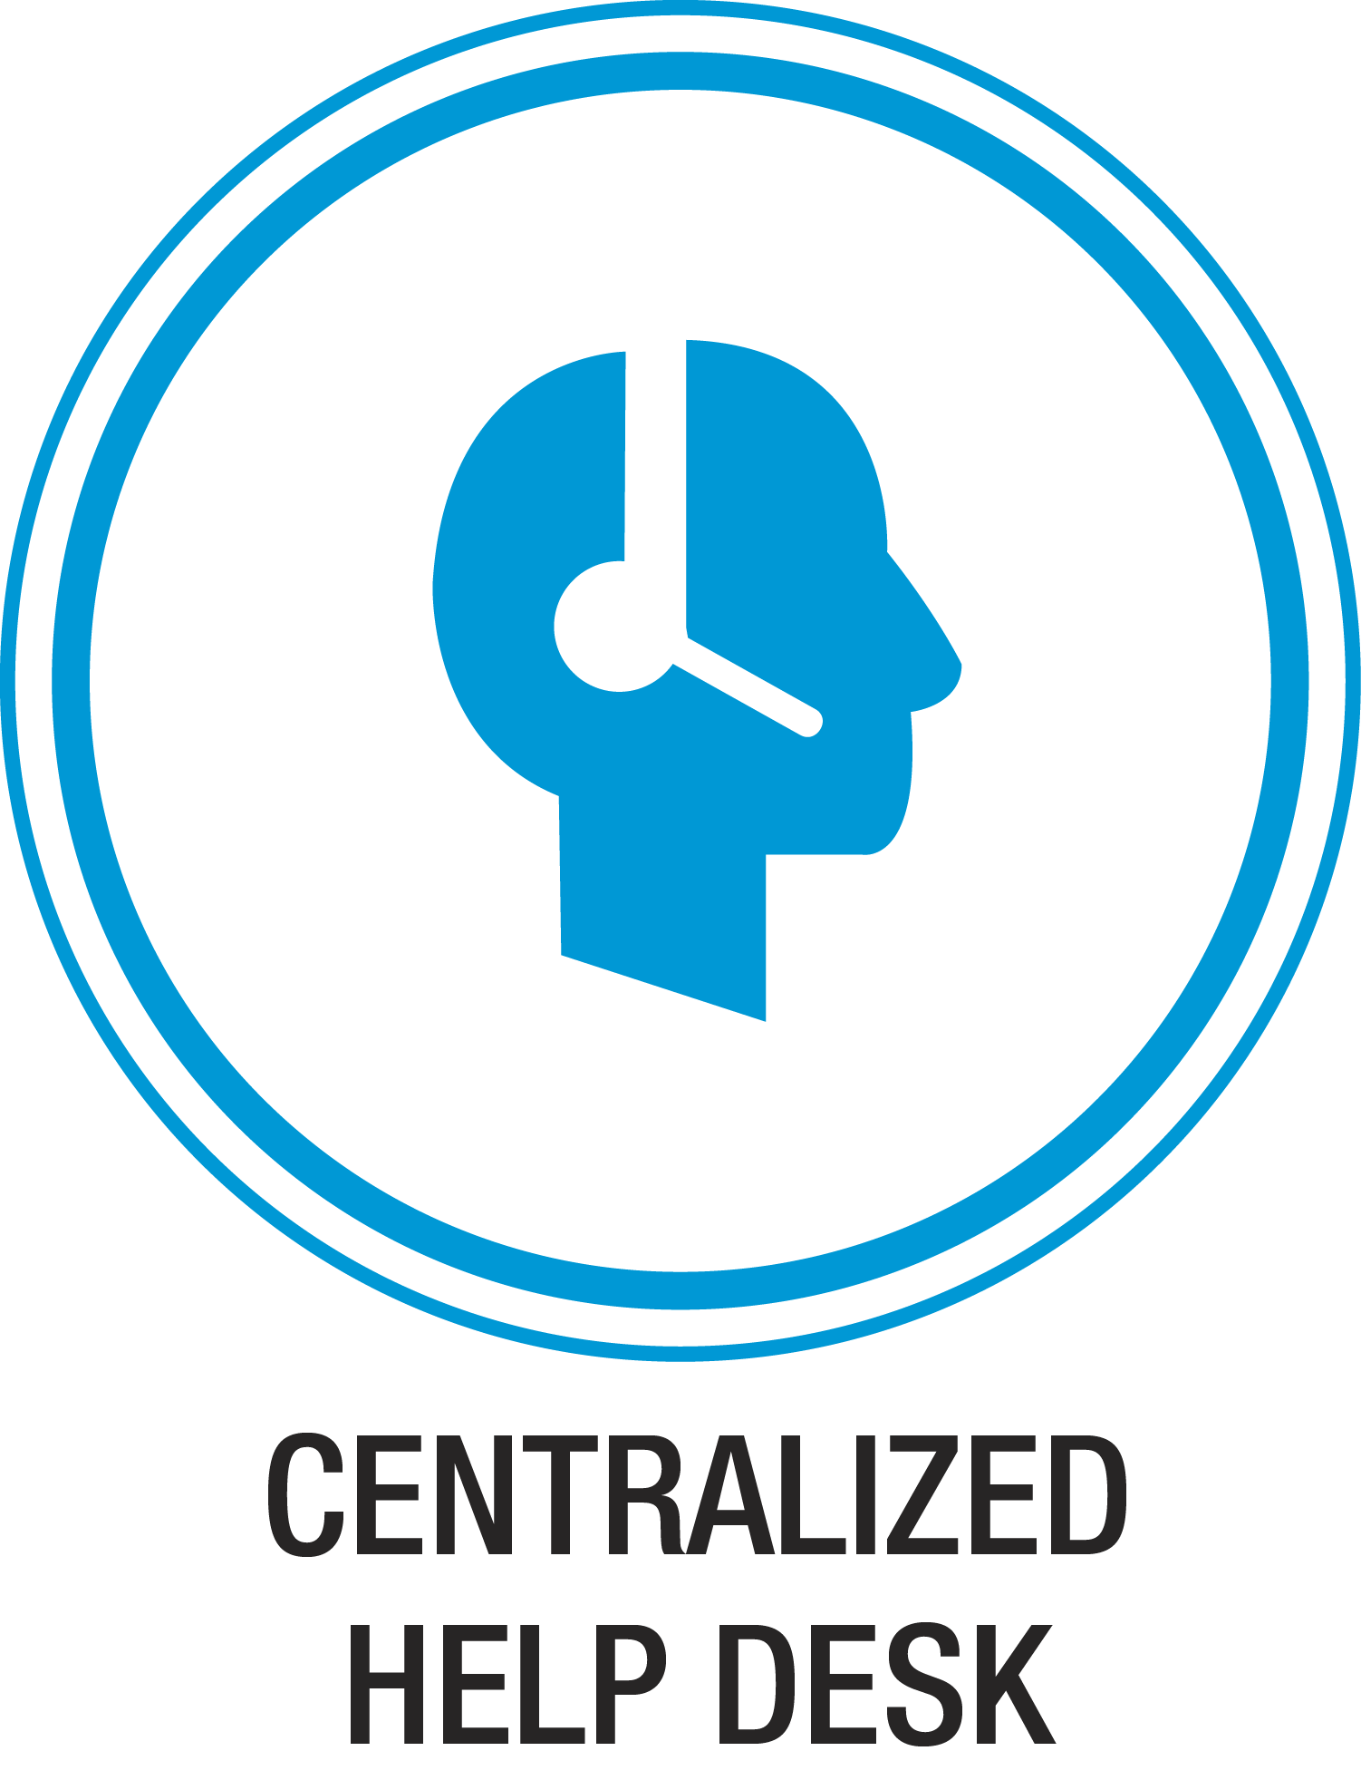

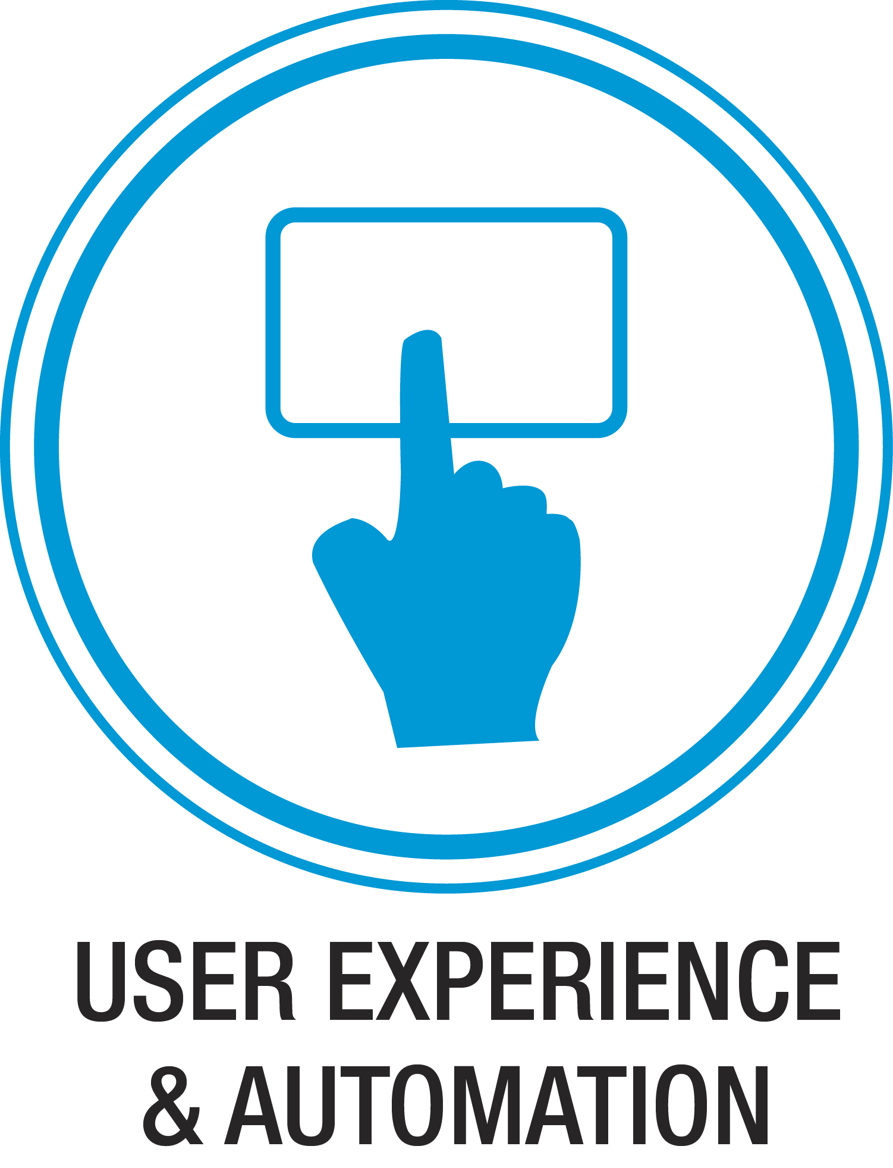



Slide 9



Global Device Management
Proactively monitor and manage,
AV devices on the network.
Notes:
This spares the organization the cost of lost productivity, and knowledge workers the hassle of having to scramble to locate a functioning room, or wait for technical support to correct the problem.

Slide 10

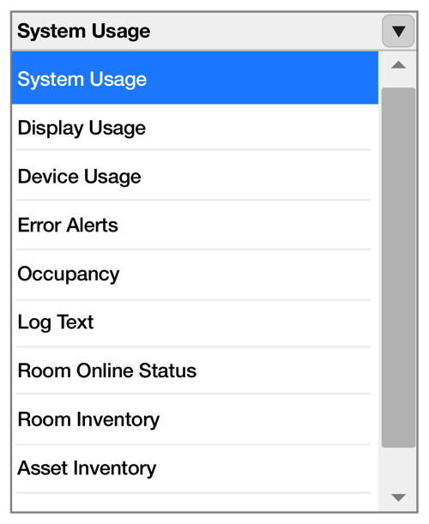
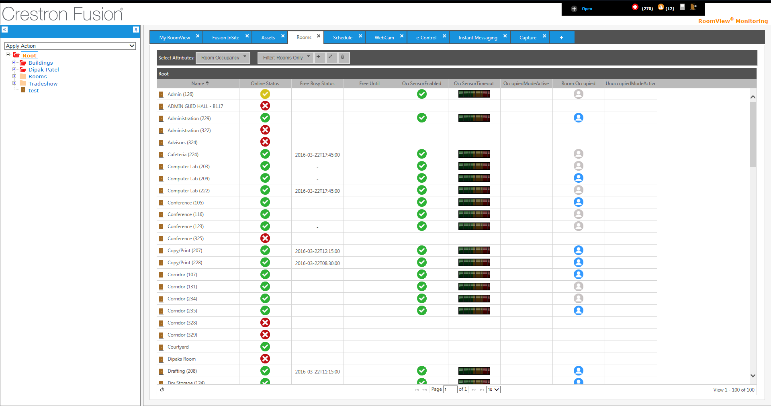
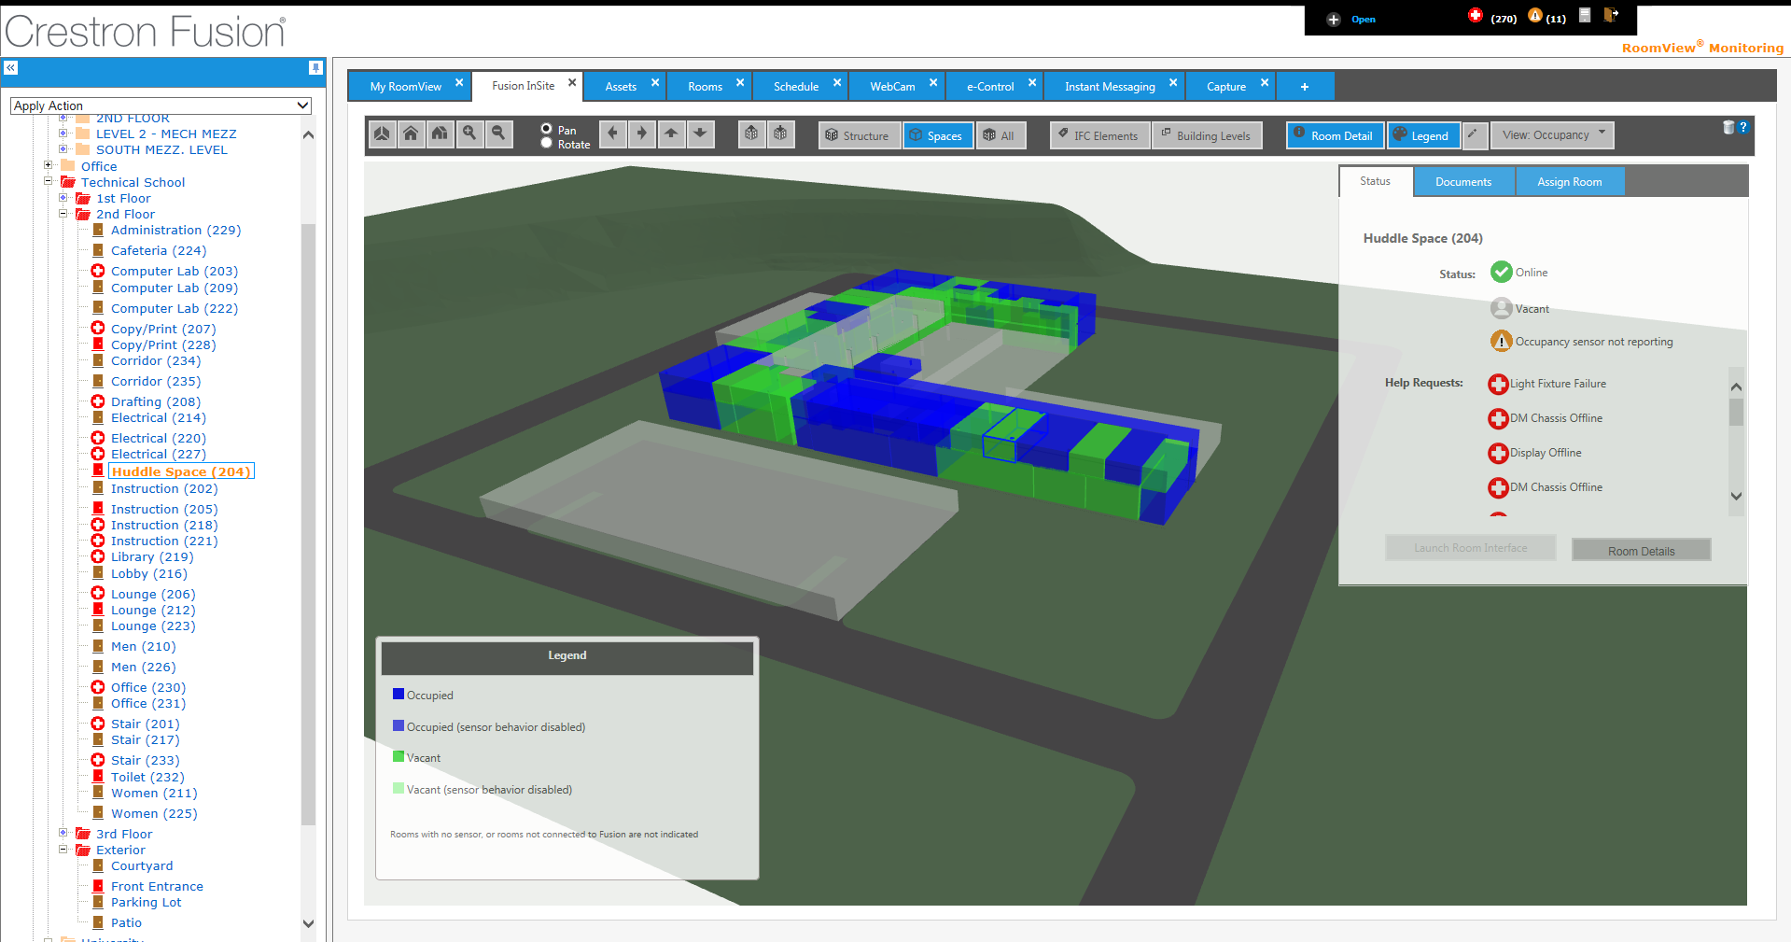




Global Device Management
Equipment status
Maintenance workflow
3D insight and visualization
Lifecycle management
Basic reporting
Notes:
Equipment Status - Instantly determine the status of equipment in any room, anywhere in the world, from a simple browser interface.
Maintenance Workflow - When a device maintenance issue arises, immediately send an alert through email or text to support staff. Crestron Fusion Cloud can also be easily programmed to connect alerts to many popular ticketing systems.
3D Insight - Get real-time 3D visualization of entire buildings across the enterprise, the status of the spaces within them, and all the technology in the rooms, making it easy to navigate, drill down, and get a better understanding of enterprise performance
Lifecycle Management – Monitor and track device usage to schedule routine preventive maintenance, such as projector lamp replacement or display calibration. Additionally, Crestron Fusion Cloud can trigger routine maintenance through alerts.
Basic Reporting - Track and get reports on room and device usage by time, date, and users. By seeing how often rooms get used, who’s using them, and the technology they’re using, you can optimize room usage and more effectively plan budgets and forecast staffing needs.

Slide 11


Advanced Scheduling
Find the right meeting space,
with the right technology, at the right time.

Slide 12
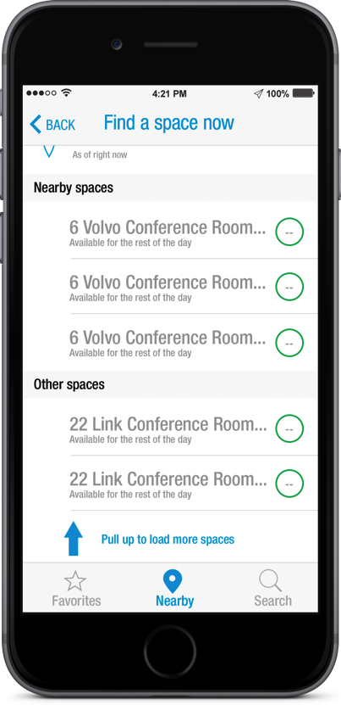

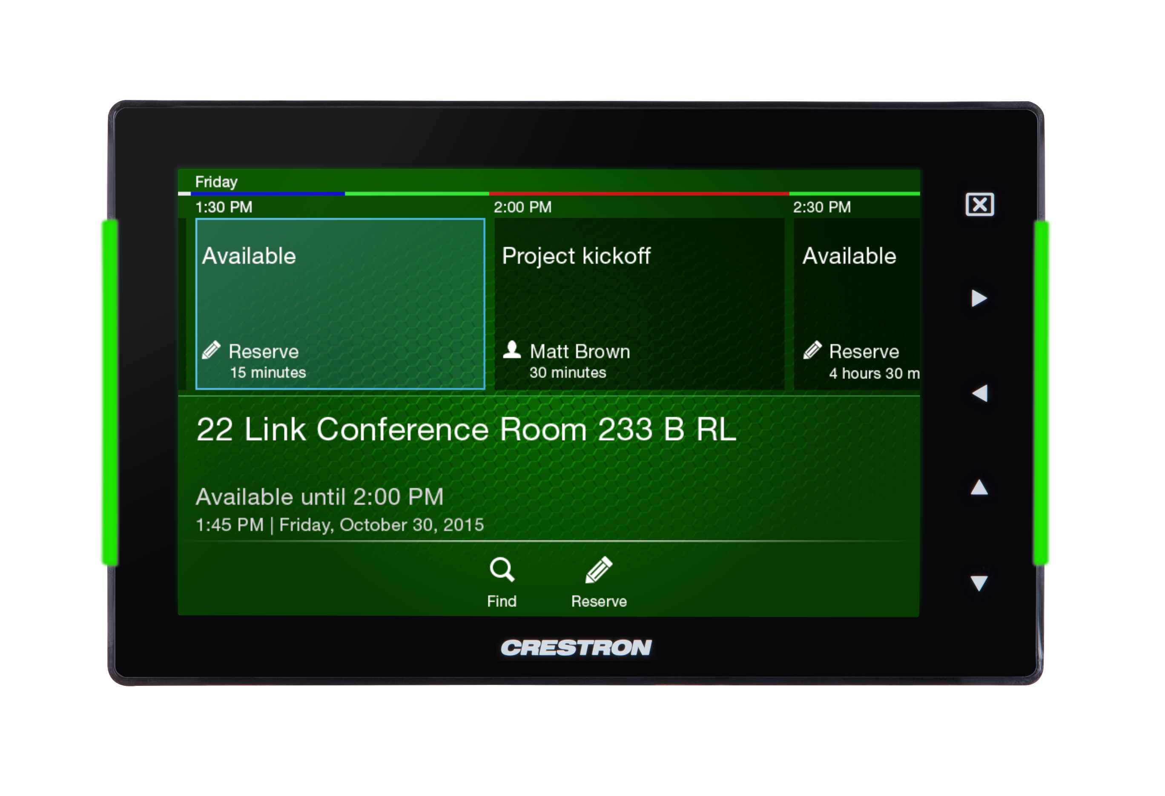



Advanced Scheduling
Native calendar integration
Real-time, in-room
status & booking
Room selection tool
Mobile contextual booking
Notes:
Native Calendar Integration – Because the Crestron Fusion Cloud Scheduling system is designed to augment your existing Outlook®, Google® Calendar™, or IBM® Notes® server, there’s no cumbersome secondary scheduling necessary. Additionally, a Crestron add-on helps enhance the functionality of Outlook® by adding filters and selectable room attributes.
Real-time, In-Room Status and Booking – The scheduling panel enables you to instantly see the status of the room, book the room, or release it back into inventory, if it’s unused. By improving the ability for teams to meet ad-hoc, the system becomes a critical part of collaboration.
Room Selection Tool - Meetings scheduled in Outlook also appear on the Crestron scheduling panel on the wall outside the room. If no one shows up for a scheduled meeting, Crestron Fusion Cloud automatically clears it from the calendar and the scheduling panel to indicate the room is available for use. The Crestron add-on for Outlook displays the appropriate rooms for each meeting based on the number of participants and technology needed, ensuring efficient resource allocation.
Mobile Contextual Booking - The PinPoint app provides a personal, mobile, dynamic scheduling tool. It provides vital contextual information to knowledge workers based on where they are, what they’re trying to do, and with whom they are working. Only the rooms with the right size, location, and technology are displayed. The PinPoint app even provides wayfinding to guide attendees to the room. Once they’re in the room, the app automatically connects to Air Media™ for wireless presentation.

Slide 13

Centralized Help Desk and Support
Resolve issues faster,
minimizing disruptions and frustration.

Slide 14
Centralized Help Desk and Support
Documentation repository
Help desk alerts
Instant messaging
Remote control
Live webcam
Live support
Notes:
Documentation Repository – By providing centralized access to all technical information such as user manuals, troubleshooting guides, and diagrams, Crestron Fusion Cloud empowers any support staff to quickly resolve issues in any room.
Help Desk Alerts – Human, or “operator,” error is inevitable. That’s why Crestron Fusion Cloud provides a direct connection from the touch screen in the room to support staff, enabling meeting participants to instantly send a help request. Pre-programmed answers to common help questions expedite the troubleshooting process.
Instant Messaging – Once the alert has been triggered, Crestron Fusion Cloud provides instant messaging capability via any scheduling panel or touch screen in the room, enabling support staff to communicate directly with meeting participants, providing comfort and accelerating resolution.
Remote Control - Enable support staff to remotely take control of the technology in the room to resolve user errors, reset room controls, turn on video conferencing, or change device settings – all without dispatching staff to the room. This provides a highly cost-effective solution for first level support.
Live Webcam – Take remote access to the next level. Crestron Fusion Cloud enables support teams to not only see what’s happening in the entire room, but also remotely control the room. This empowers support teams to resolve issues like never before, with the ability to see the results of their efforts in real-time.
Live Support - By leveraging Rava® SIP intercom technology, Crestron Fusion enables meeting participants to chat live with support staff to expedite resolution of technical issues. Local support staff can also engage with centralized technical support to tackle the most demanding issues.

Slide 15
Broadcast Messaging
Quickly and effectively broadcast corporate communications or urgent information directly to all or select displays and Crestron touch screens.

Slide 16
Broadcast Messaging
Emergency announcements
Notes:
Crestron Fusion Cloud provides the platform to increase your emergency preparedness. You can create and store instructions, safety protocols, and images, that can be evaluated and perfected before critical situations arise.
Custom directions can be distributed and displayed on a room-by-room, floor-by-floor, building-by-building, or even entire geographic location basis. In the event of an emergency, broadcast messages can automatically override content on Crestron Connected™ displays and on Crestron touch screens in the room.

Slide 17
User Experience and Automation
Improve the day-to-day user experience of employees. Enable people to focus on their work, instead of on getting things to work.

Slide 18
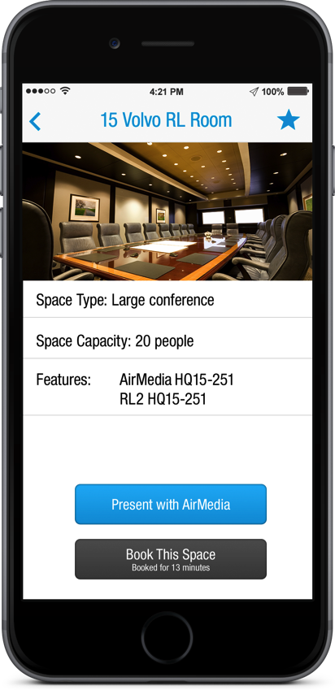
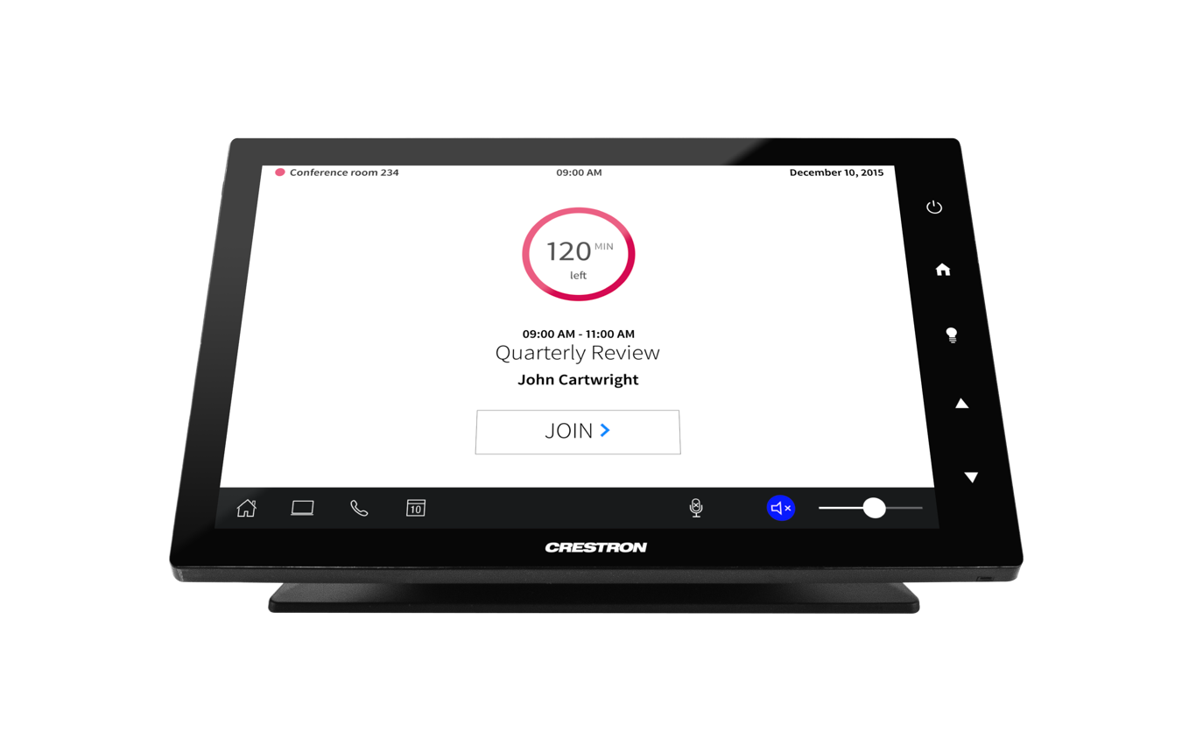



User Experience and Automation
No-touch startup
One-touch videoconferencing
Dynamic mobile content sharing
Audio & video capture
Post-meeting reset
Notes:
No-Touch Startup – Simply enter a room and instantly present content from your mobile device on the room display. No buttons, no confusion. Rooms can be programmed to automatically set lighting levels and shade positions to ensure an optimal presentation or video conferencing experience.
One-touch Video Conferencing – By eliminating confusion, knowledge workers are more likely to utilize the investment in video conferencing systems. A single “Join Video Conference” button on the touch screen provides an intuitive way to start a collaboration session.
Post-Meeting Reset - Once a meeting is concluded, knowledge workers can simply leave and Crestron Fusion Cloud will automatically reset the room. This ensures participants in the next meeting can enjoy the same great experience, eliminating the frustration of walking into a room still on a video bridge, or with the lights dimmed.
Dynamic Mobile Content Sharing
With PinPoint installed on team members’ personal devices and AirMedia installed in the meeting rooms, knowledge workers can quickly display content from their smart devices as soon as they enter the space. This simple, intuitive methodology enables them to more quickly and naturally share content.
Audio and Video Capture
By integrating Crestron Capture HD®, you can record lectures, presentations, meetings, and more. The system can automatically push the video to a server for processing, so you can quickly review, store, and access content for streaming.

Slide 19


Asset and Space Utilization
Crestron Fusion Cloud can
generate usage and analytic reports
on all meeting spaces and all the technology in them.
Notes:
Connection Preferences
Track the means through which knowledge workers physically communicate – VGA vs. HDMI® vs. wireless, for example. Insights can be gleaned from this data that influence technology purchase decisions, and raise awareness of the need for training to ensure all knowledge workers know how to use all the tools available to them.
Asset Utilization
Device usage reports provide the information you need to better allocate your IT budgets: how often is a single display used, versus a dual display; how often is video conferencing used, as opposed to audio conferencing. By making relative judgments between rooms, buildings, and geographic locations you can better understand the usage patterns of teams to improve utilization and reduce costs.
Space Utilization
By tracking room usage you can optimize space utilization and eliminate inefficiencies. Booked but vacant rooms can be released for use. Identify rooms that are typically misused. For example, a weekly meeting with only a few local participants is occupying a large video conference room, precluding a larger group that needs to video conference with remote colleagues from meeting. Identify underused rooms, so valuable space can be reallocated or repurposed.

Slide 20



Asset and Space Utilization
Connection preferences
Asset utilization
Space utilization
Notes:
Connection Preferences
Track the means through which knowledge workers physically communicate – VGA vs. HDMI® vs. wireless, for example. Insights can be gleaned from this data that influence technology purchase decisions, and raise awareness of the need for training to ensure all knowledge workers know how to use all the tools available to them.
Asset Utilization
Device usage reports provide the information you need to better allocate your IT budgets: how often is a single display used, versus a dual display; how often is video conferencing used, as opposed to audio conferencing. By making relative judgments between rooms, buildings, and geographic locations you can better understand the usage patterns of teams to improve utilization and reduce costs.
Space Utilization
By tracking room usage you can optimize space utilization and eliminate inefficiencies. Booked but vacant rooms can be released for use. Identify rooms that are typically misused. For example, a weekly meeting with only a few local participants is occupying a large video conference room, precluding a larger group that needs to video conference with remote colleagues from meeting. Identify underused rooms, so valuable space can be reallocated or repurposed.

Slide 21


Smart Building Integration
Automatically create comfortable, productive work environments in meeting spaces.
Reduce energy consumption by automatically turning off lights and setting back HVAC use in unoccupied spaces.

Slide 22


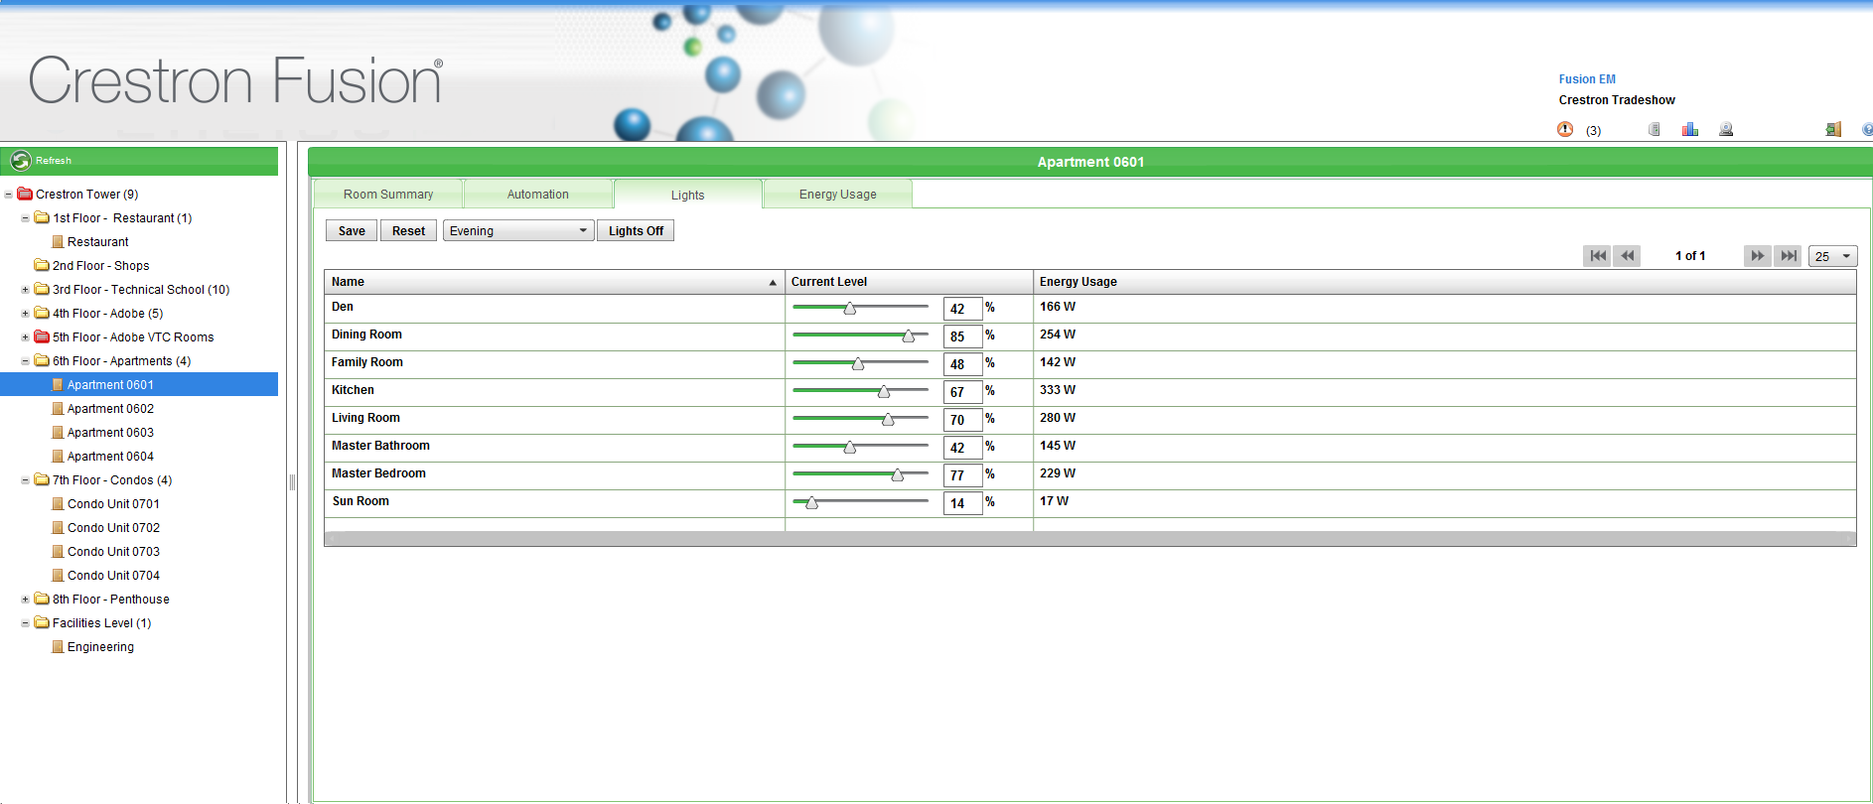


Smart Building Integration
Power consumption
monitoring and control
Lighting levels and control
Intelligent routines:
HVAC, lighting, and shades
Building Management Systems
(BMS) integration
Notes:
Power Consumption Monitoring and Control
Monitor, measure, manage, and control lighting, HVAC systems, and energy usage in every space. By understanding how energy consumption on one floor compares to another, or one building to another, it provides the relative data you need to identify issues and opportunities for improvement.
Lighting Levels and Control
Centrally control all lighting levels. This can be routine based, ensuring buildings draw as little power as possible during non-working hours. It can also be schedule based, activating spaces for specific meetings or events. Lastly, it can be adaptive. By leveraging light sensors, lighting and shading can automatically adjust based on current room conditions.
Intelligent Routines: HVAC, Lighting, and Shades
With its ability to fully integrate with HVAC systems, lighting controllers, and automatic motorized shades, Crestron Fusion Cloud enables you to create intelligent routines. You can perfectly balance natural light, electric light, and room temperature, while understanding if the room is occupied and how it’s being used, to provide a comfortable work environment and energy efficient building.
Building Management Systems (BMS) Integration
Crestron Fusion Cloud is not a replacement for existing building management systems (BMS). It’s designed to leverage information provided by the BMS so you can make data-driven, cost effective decisions regarding lighting, temperature, and shading levels to reduce power consumption. Crestron Fusion Cloud communicates with the BMS via BACnet, working together to optimize power consumption across the organization.

Slide 23

Flexible Deployment Options
Crestron Fusion Deployment Group
Help you identify your organizational goals and tailor an implementation that meets your needs
Flexible, scalable platform
you can grow on
Monthly cloud service includes the initial deployment, configuration, training, and ongoing support
On-premises available with 3 year support contract
Hosted Scheduling Service
If you simply want to take advantage of world-class Crestron scheduling panels, you can work with our Crestron Fusion Deployment Group to set up your hosted account and point your scheduling panels at the server

Slide 24
Deployment Process
Sales
Project Definition
System Deployment
Support
Sales Presentation
Application
Requirements
Solution
Requirements
Meeting
Proposal Generation
Kick-off
Meeting
Programming,
Server Setup,
Software
Configuration
Validation
Follow-up,
Maintenance,
& Upgrades
Educate – Define project goals, identifying client needs.
Scope – Define scope of work & propose a solution to the client’s needs
Deploy – Provide programming , configuration, and setup guidance and oversight to implement the solution
Support – Ensure long-term satisfaction, system usage and uptime

Slide 25
Built on a Hardware Platform
The future of meeting spaces
Consistent experience
Scalable, repeatable
  Boardroom
  Conference rooms
  Huddle spaces
  Training rooms
.AV Framework™ operating system
  Plug-and-play
  No programming required
Notes:
PinPoint is a game changed and an important part of the conversation, but let’s look at some important elements of the meeting room that can continue to change the workplace.

Slide 26
Built on a Hardware Platform
Notes:
Inspired by leading edge companies like Coke, many huddle spaces and meeting rooms have an open concept. The displays can play a big part in changing the entire feeling of the workplace, so why not use that to our advantage? The new meeting room uses the display as “digital signage” for productivity - Imagine being able to glance into a room and know the schedule for the room, or presenting Airmedia connectivity information for visitors along with general room usage guidance in a great looking format where they can’t miss it? The OSD truly brings the workplace to life, and let’s face it most all companies want that “cool factor” today – this brings it big.

Slide 27
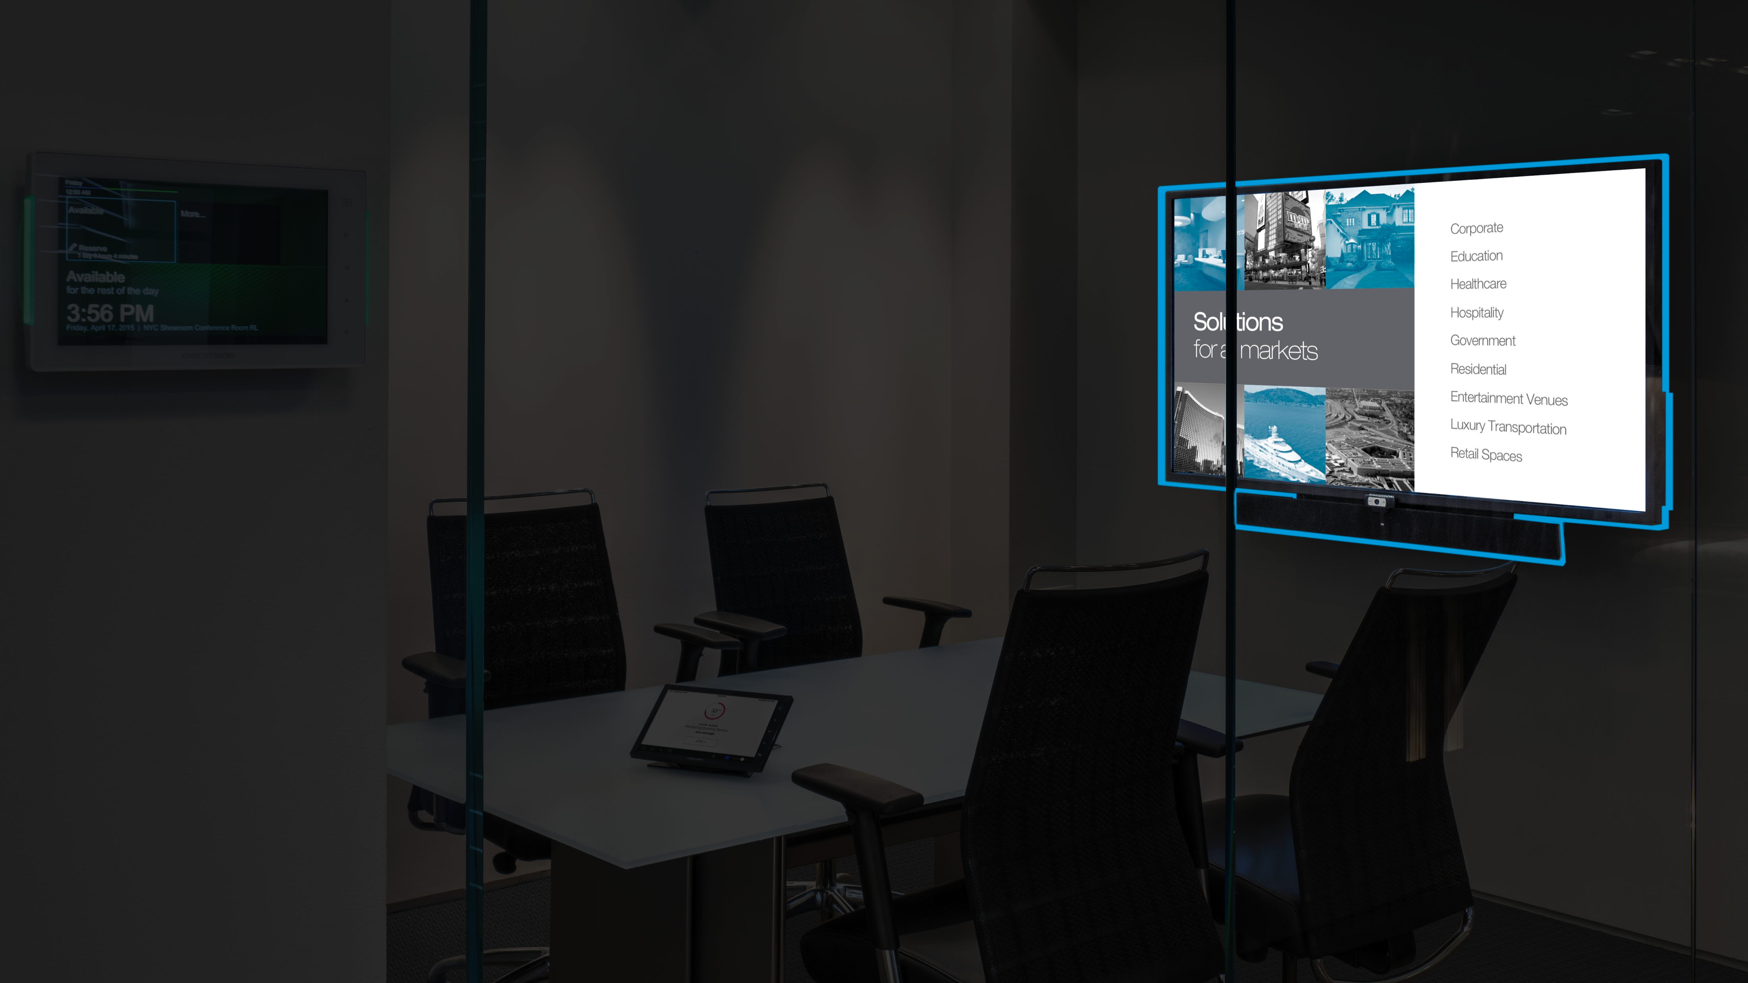
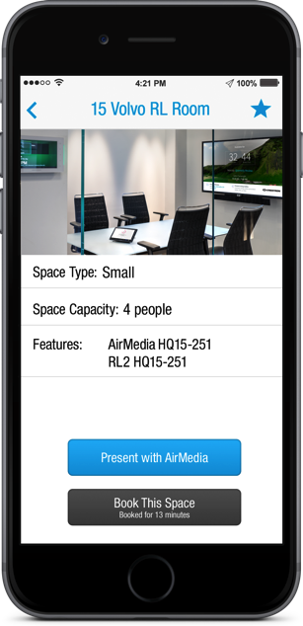
Built on a Hardware Platform
Notes:
The demand for BYOD continues to increase, so connectivity with AirMedia has become a standard. It’s the only mobile device solution on the market with Enterprise management and security built in, and more exciting features are on the way.

Slide 28
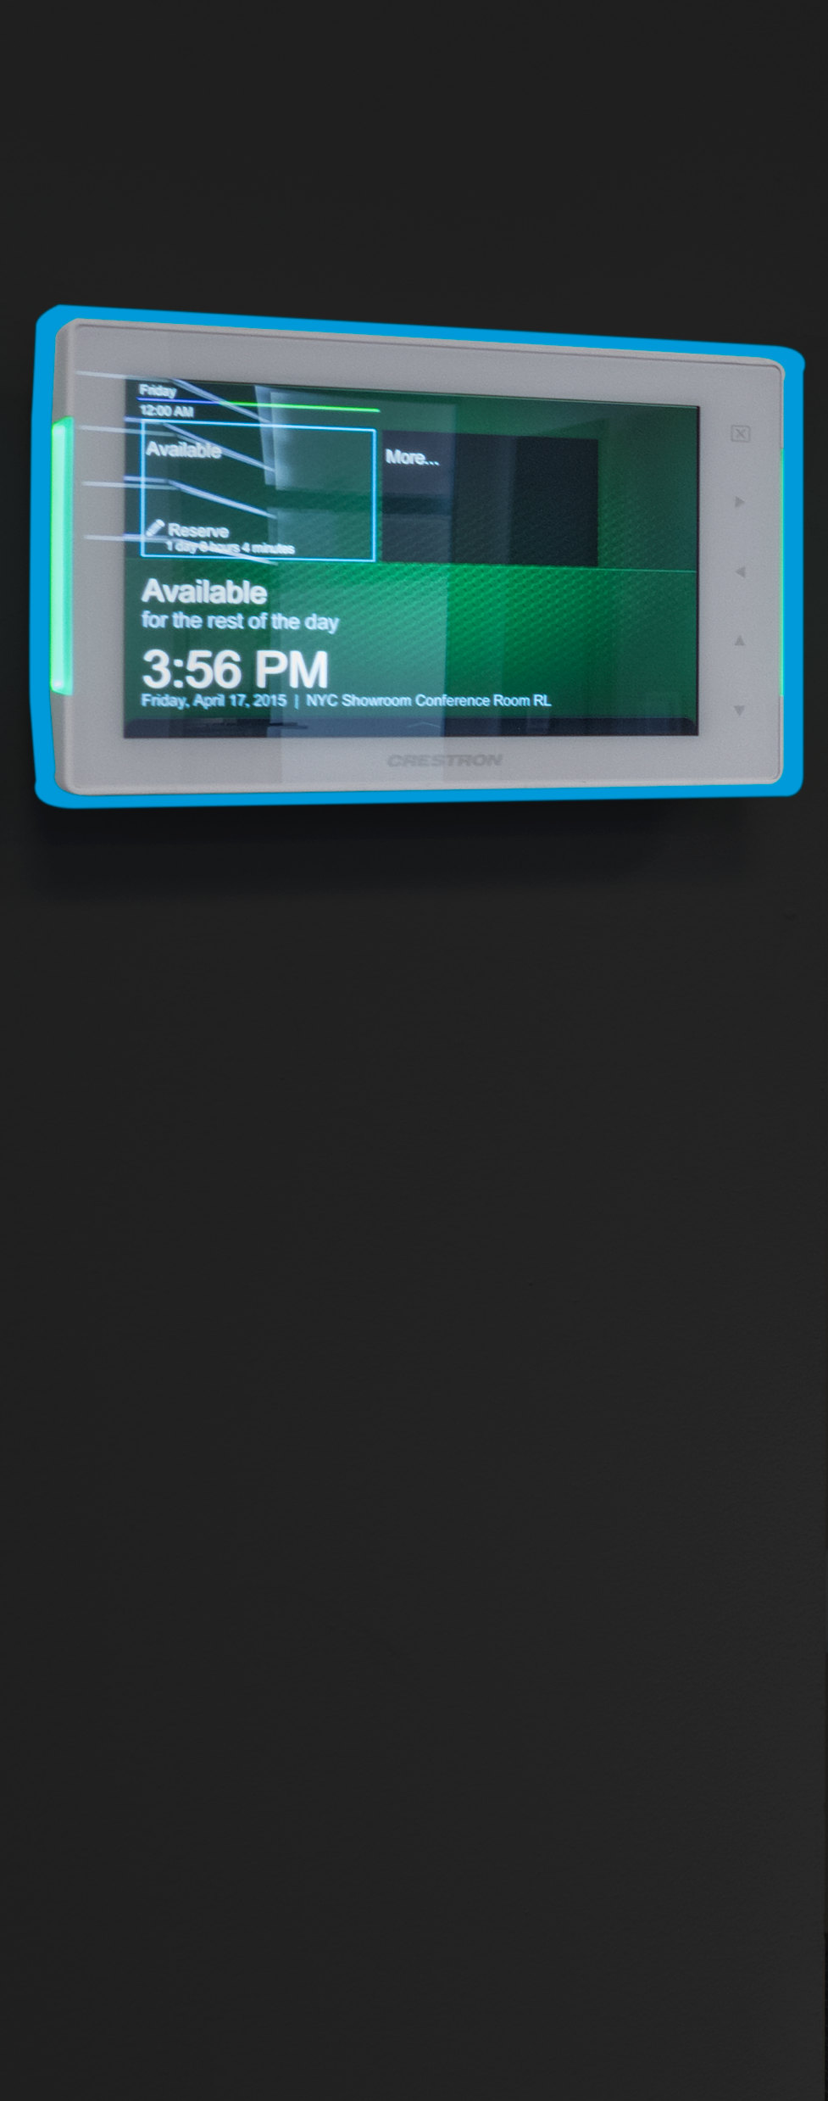
Built on a Hardware Platform
Notes:
Let’s not forget about HDMI and VGA connectivity. There is still a high value for organizations to have true bit for bit, uncompressed, zero latency, 4k HD video on the display with DM

Slide 29
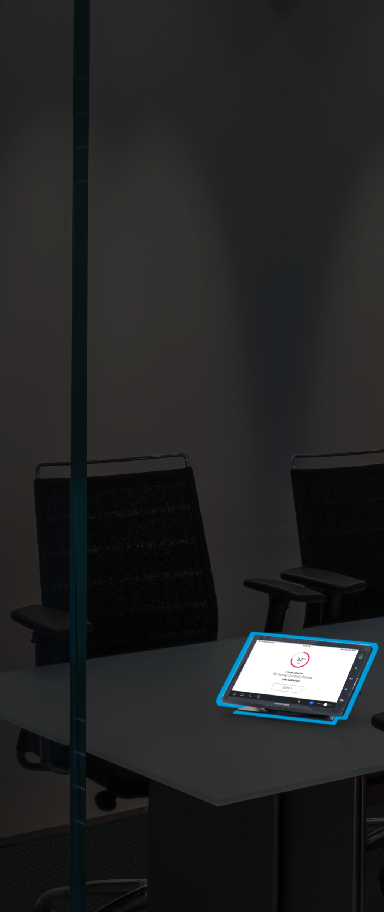
Built on a Hardware Platform
Notes:
Let’s not forget about HDMI and VGA connectivity. There is still a high value for organizations to have true bit for bit, uncompressed, zero latency, 4k HD video on the display with DM

Slide 30



The Foundation of the Intelligent Enterprise
DM® 3.0, a secure and
scalable hardware platform
Crestron Fusion Cloud manages the global network of devices
PinPoint creates a great end user experience throughout the day

Slide 31





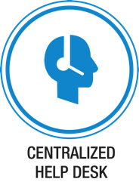





All brand names, product names, and trademarks are the property of their respective owners. Certain trademarks, registered trademarks, and trade names may be used in this document to refer to either the entities claiming the marks and names or their products. Crestron disclaims any proprietary interest in the marks and names of others. Crestron is not responsible for errors in typography or photography. ©2016 Crestron Electronics, Inc.

