Slide 2
Crestron 70 Series Touch Screens
Expand your reach
crestron.com/touchscreens

Slide 3

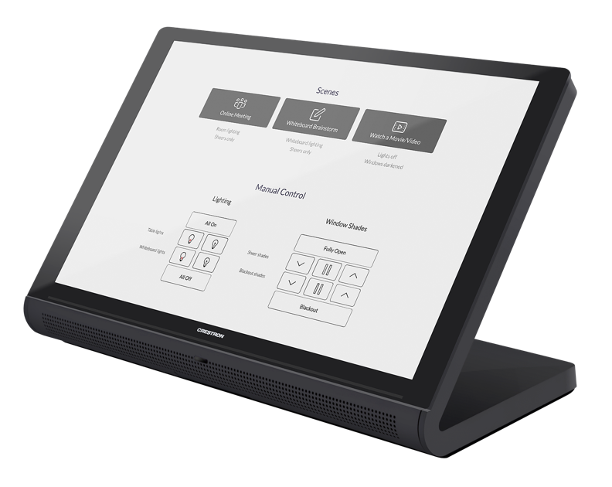
As dynamic as any smart device
Designed for anywhere people share information, connect with technology, and/or command a space
    At work
    On campus
    At home

Slide 4
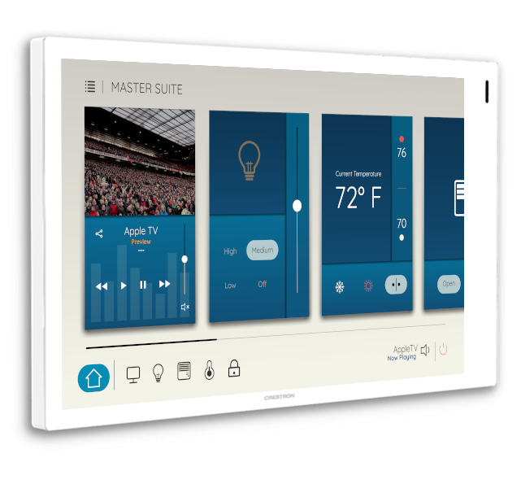
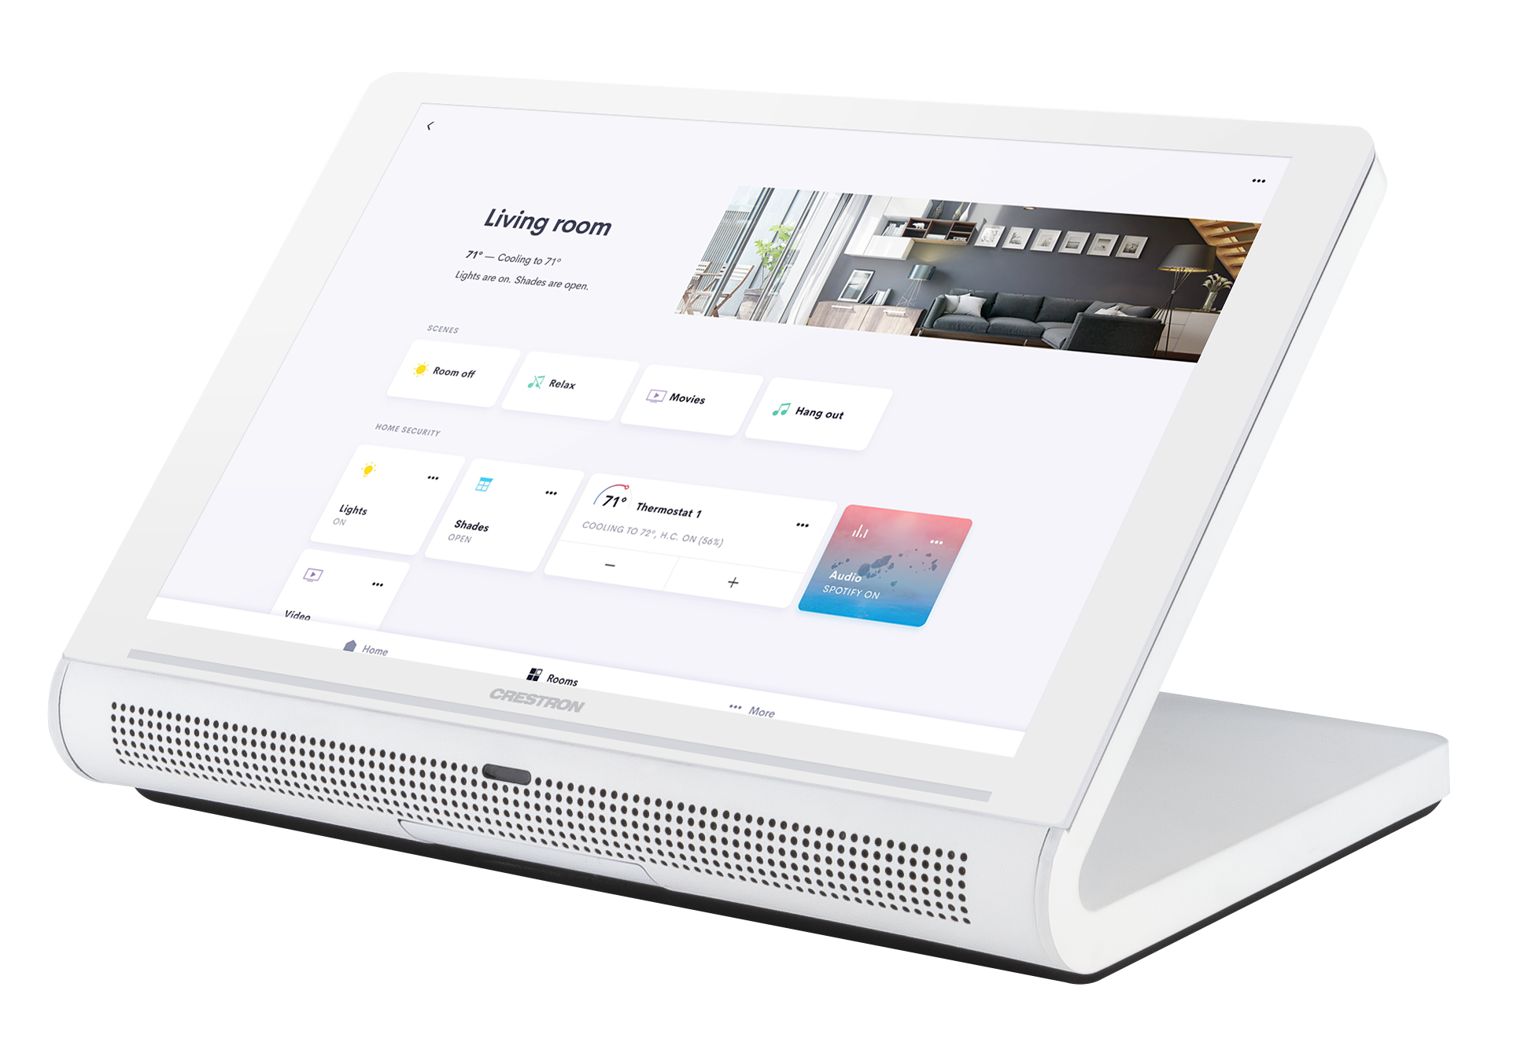
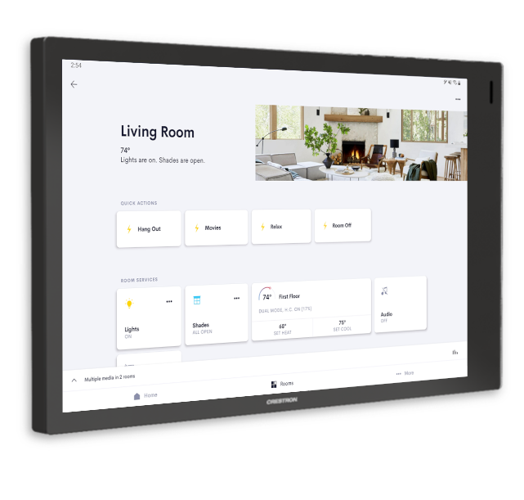

Modern design solving for two distinct spaces
On the Wall – compact size with thin bezels
On the Tabletop – All-in-one design
Sizes: 5”, 7” and 10”
Sizes: 7” and 10”

Slide 5


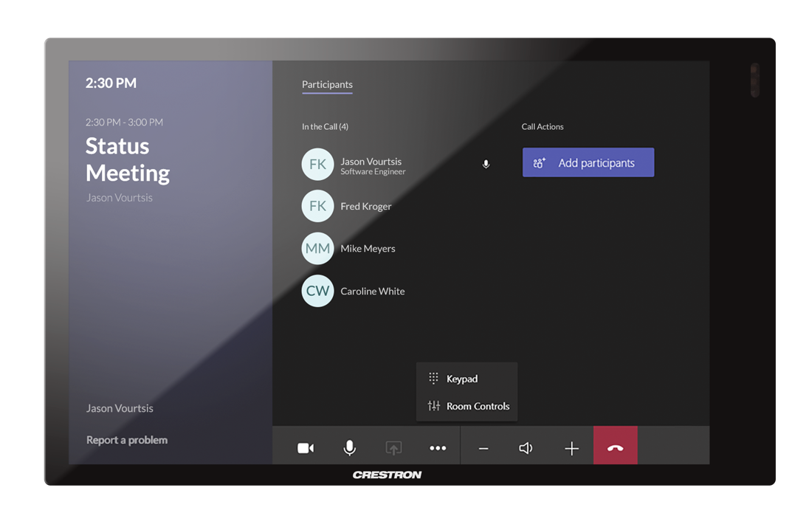
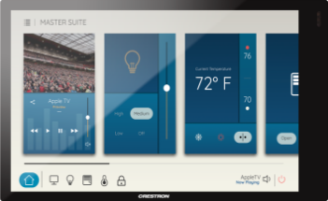

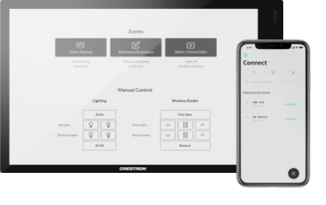
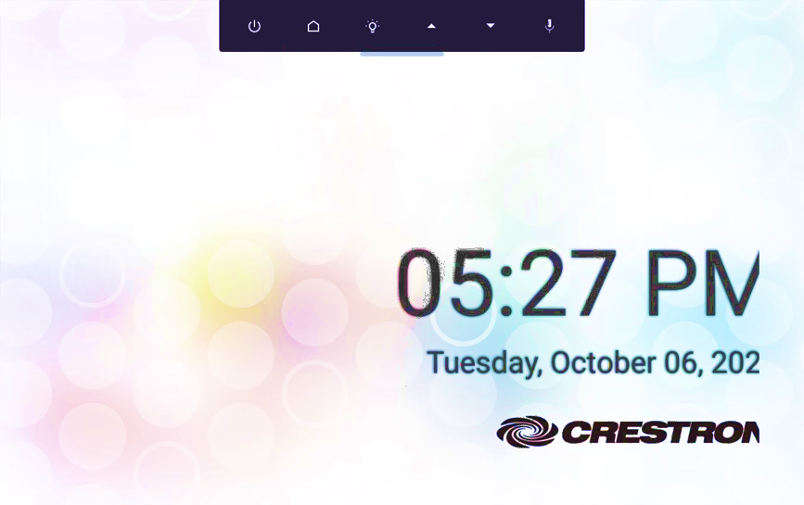
Design that delivers responsive, dynamic, and intuitive control
Proximity Sensor
Key features
    Proximity sensor detects motion and awakens the screen upon approach
    Enlarged display surface, higher resolution: H.265
    Wi-Fi® capabilities and PoE+ installation for maximum flexibility and convenience
    Built-in Bluetooth® beacon enables Crestron One™ room control from mobile devices
    Auto brightness: day and night mode
    Soft programmable virtual buttons
    Customizable Screen Saver (Videos, Images)
    Custom designs with HTML5 or Smart Graphics
    Enterprise-grade security:
    802.1x, TLS, FIPS-140-2, SSH, SFTP
Soft Virtual Buttons
Notes:
Why Wireless?
Use local PoE injectors to bring into any space without the need pull ethernet back to a central switch.
Reduce cost with ethernet pulls and ongoing ethernet management fees.
Quickly turn up any space and for locations not easily able to have an ethernet cable pull.
Wireless
IEEE 802.11a/b/g/n/ac Wi-Fi (2.4 or 5 GHz 2-way RF)
Available in 7” and 10” versions of TSW, TSS, TS versions.
Government version removes, not disables, Wi-Fi, Microphone, and Bluetooth
Wi-Fi adaptor may be enabled/disabled
Wireless will have the following encryption
WEP, WPA, WPA2
WPA & WPA2 Enterprise (forthcoming after launch)
Wired
Wired takes president over Wi-Fi if both are enabled

Slide 6
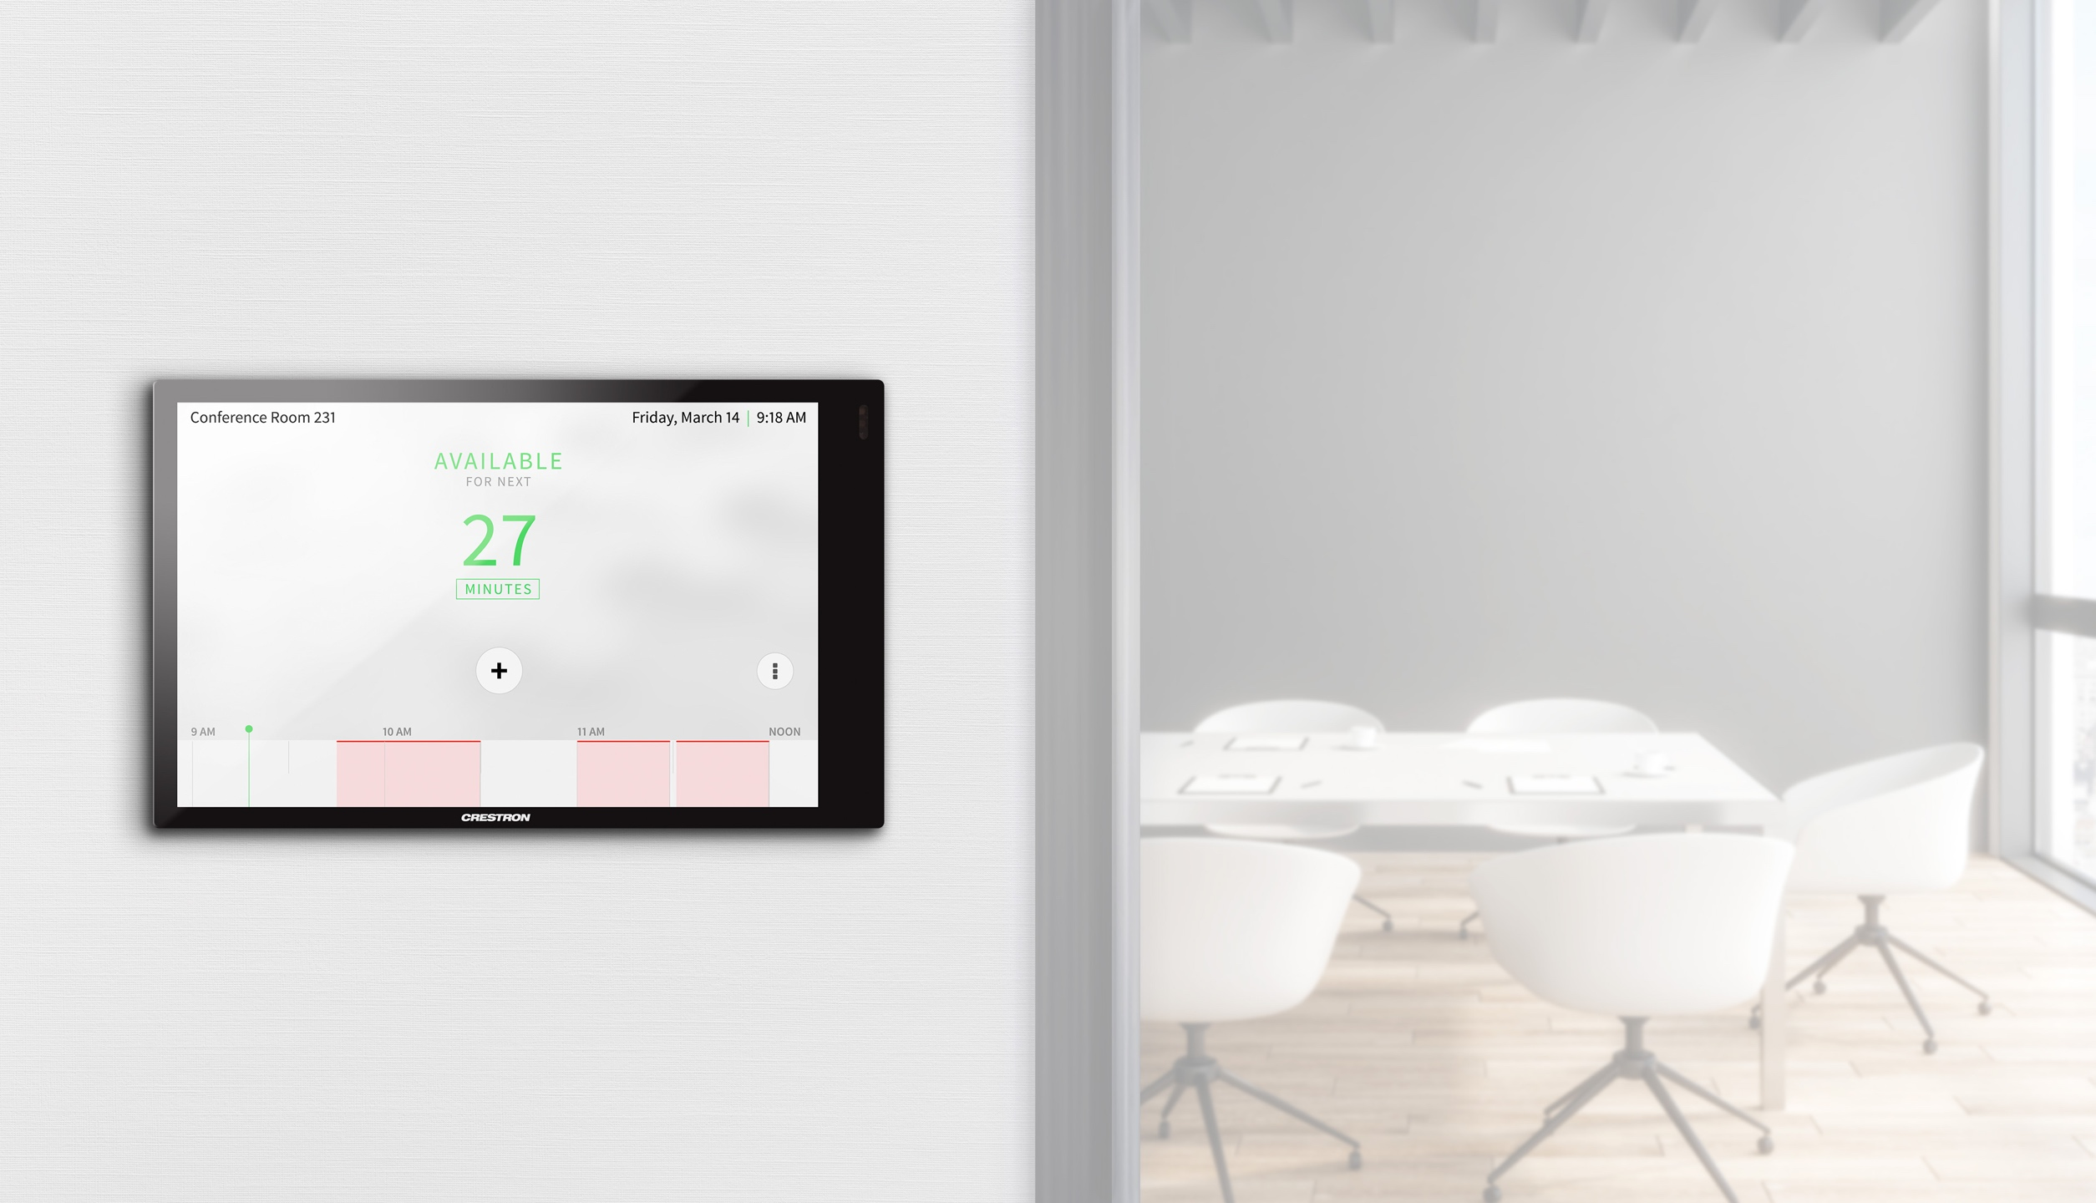
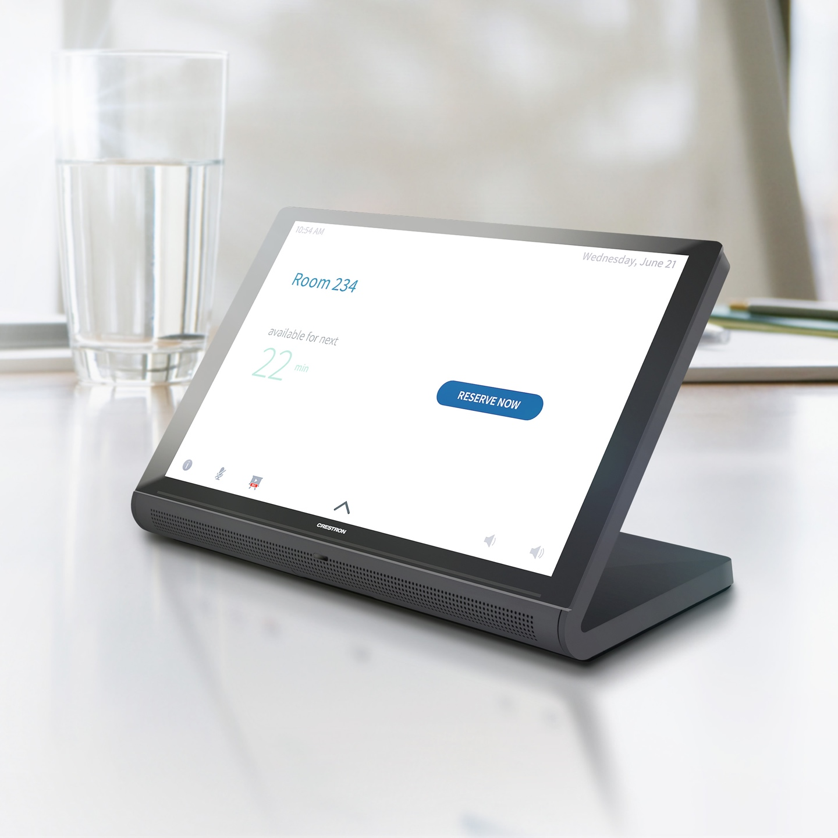
Designed for anywhere you work.
“The finish and design, it matches our modern office.”
- Andy Jones, Fishtech Group

Slide 7
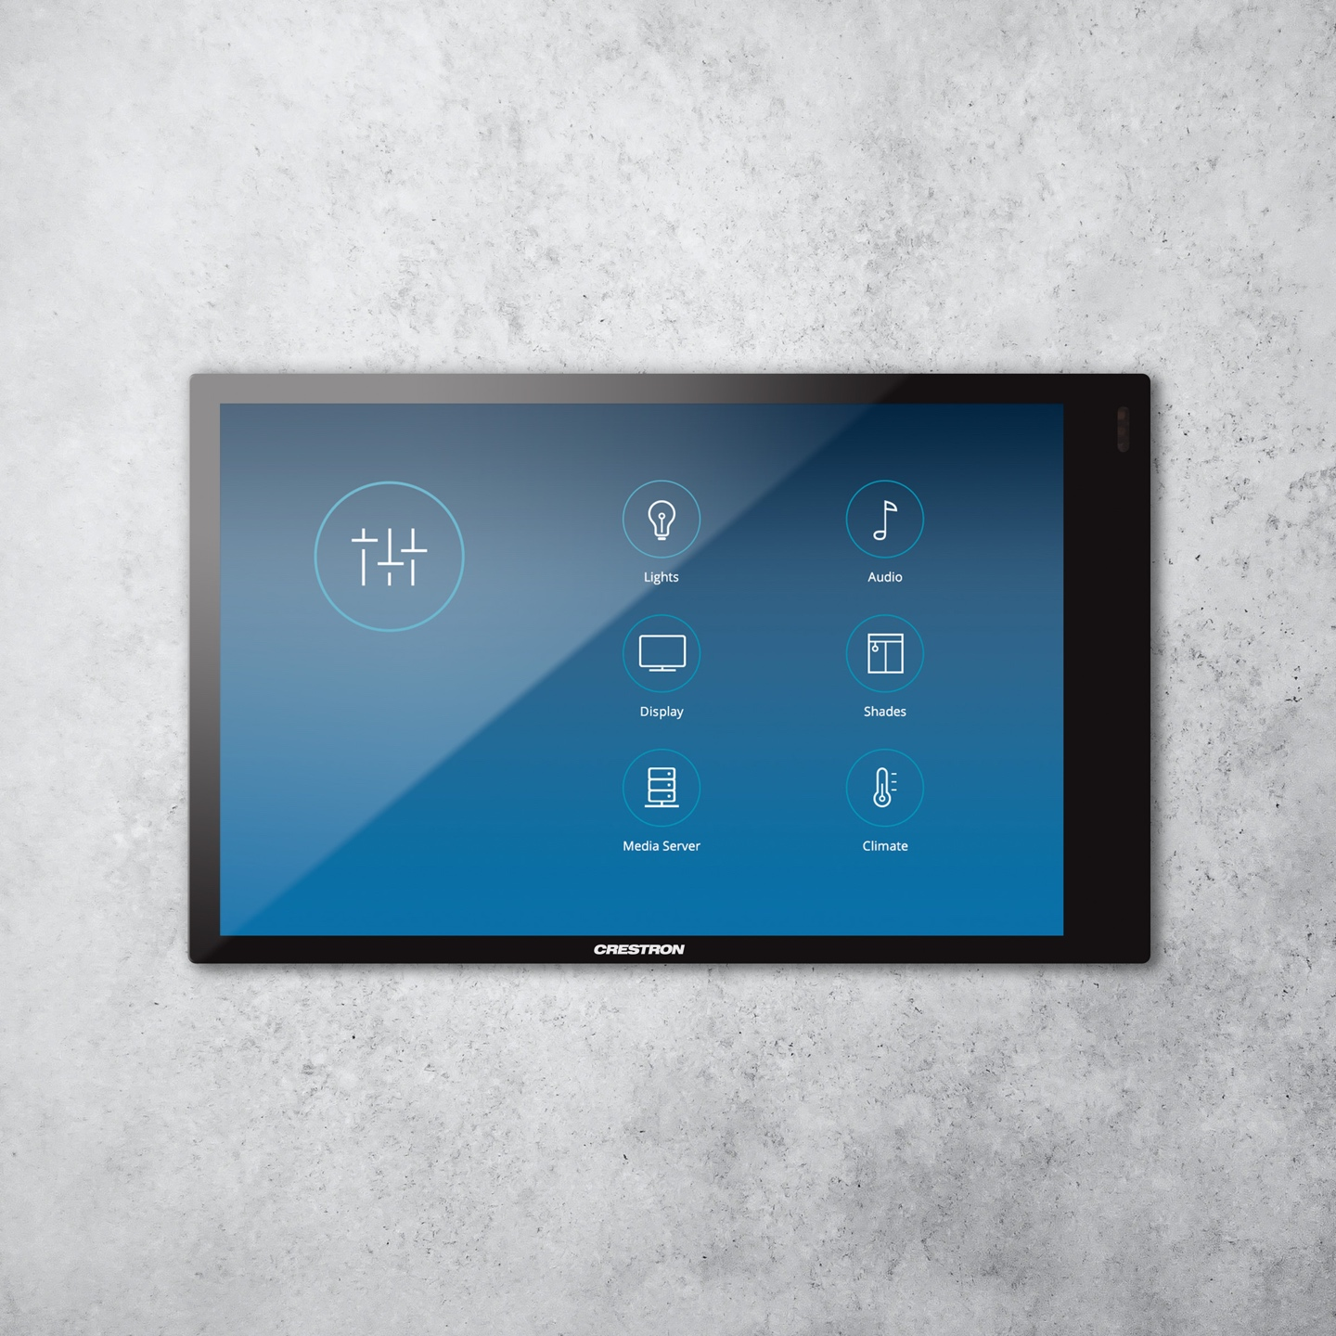
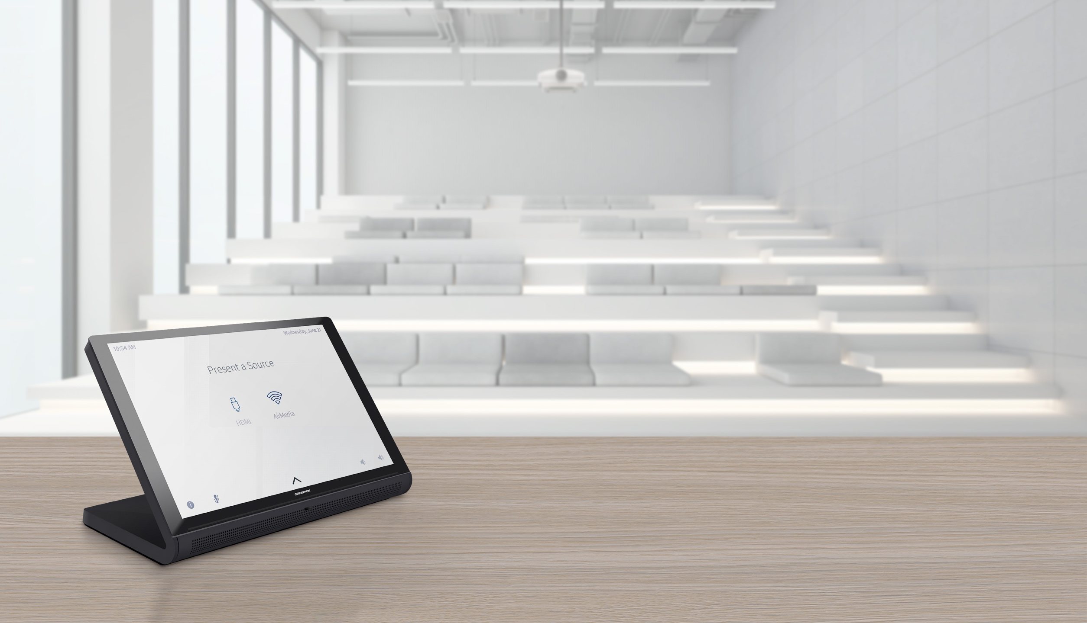
Designed for anywhere you learn.
“I like a lot of the new features, and personally like the form factor and removal of hard buttons (only because we don’t use them in our systems so it nice to not have them on the hardware).”
-Mike Bartolucci, MIT

Slide 8
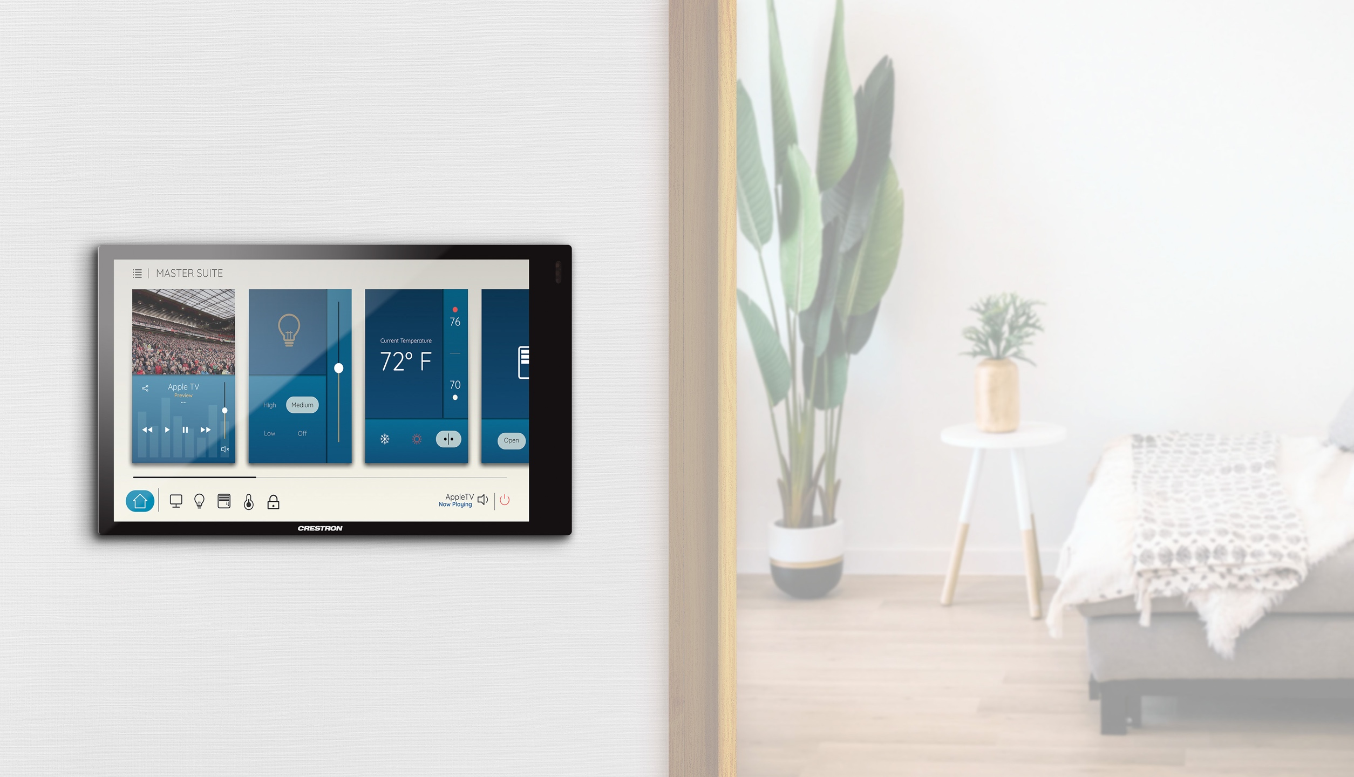
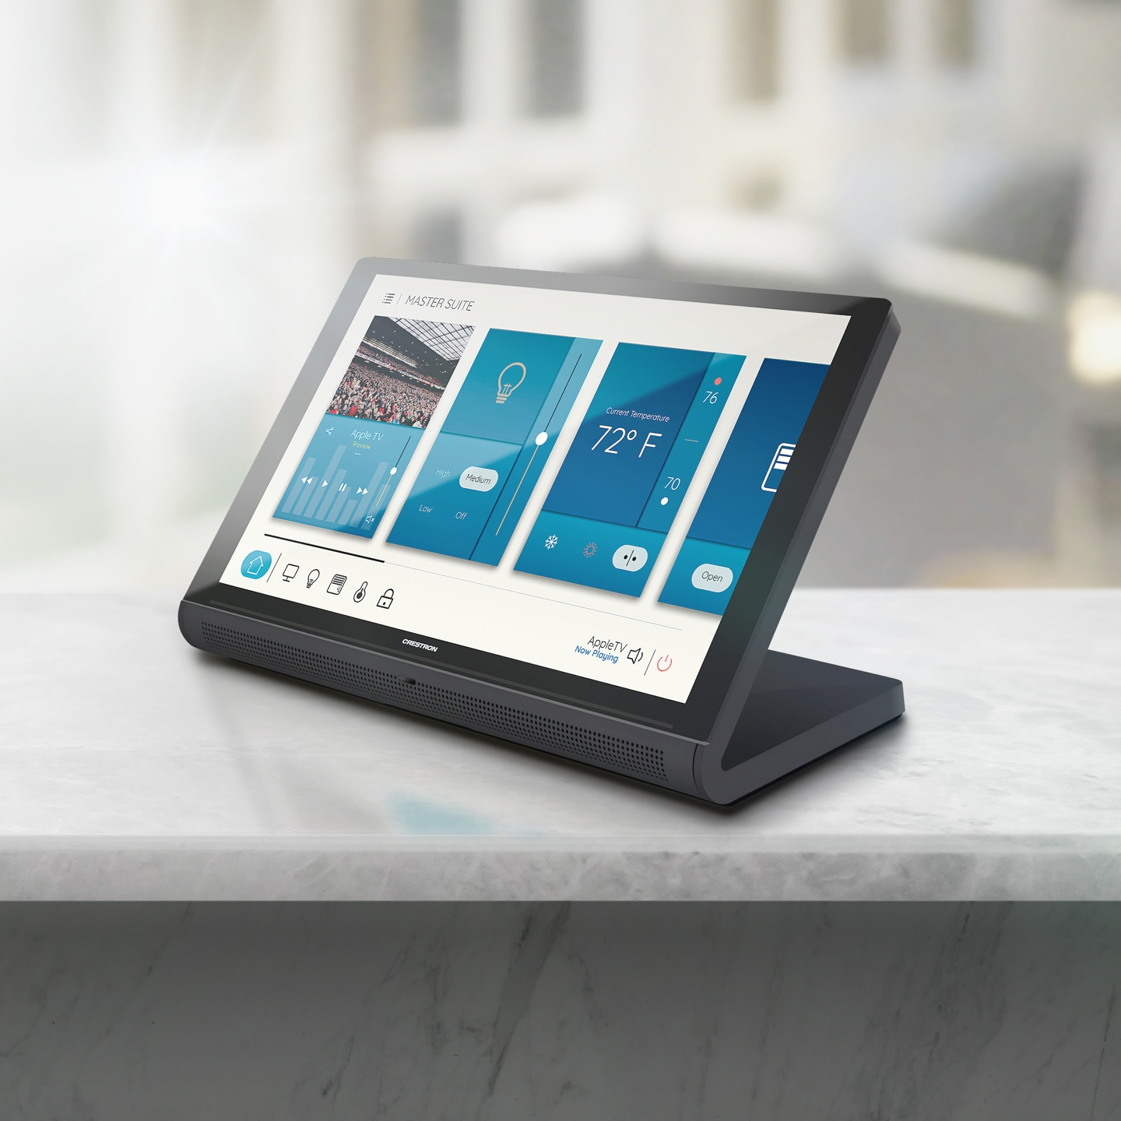
Designed for anywhere you live.
“I am LOVING the new capabilities of the screen saver with this touch screen. This may sound silly, but the video background is a game-changer.”
-Jared Ross, AHT Global

Slide 9
Design that showcases identity and preferred experience
Out of the Box
  Select your application or user project
  Choose desired mode
  Connect to the broader system
  Engage
Natively supported applications:
  Crestron Flex UC solutions
  Crestron room scheduling solutions
  Crestron Home™ solutions

Slide 10
Design that showcases identity and preferred experience
Configurable
  Deploy consistent user experience with Crestron .AV Framework™ software
  Showcase brand identity
    Customize icons, background, logos
    and screen savers
Learn how at Crestron Technical Institute

Slide 11
Design that showcases identity and preferred experience
Customizable
  Build a complete customer UI using HTML5
  or VT Pro-e® software
  Build utilizing standard and common web
  and app development tools
  Dynamic build
  One interface to be utilized across any size touch screen
Learn how at Crestron Technical Institute

Slide 12
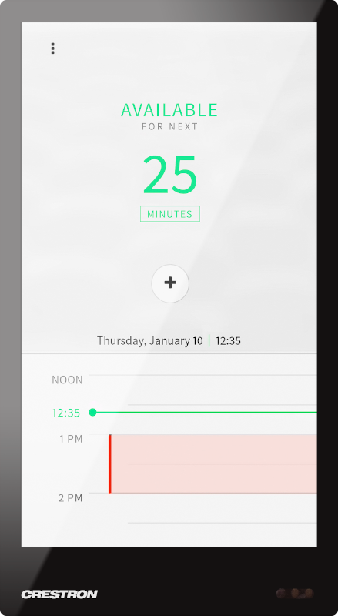
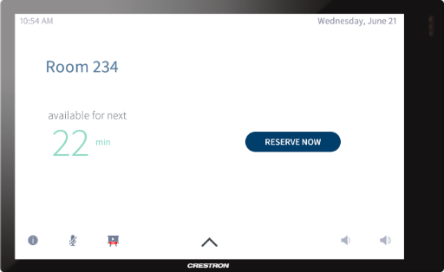

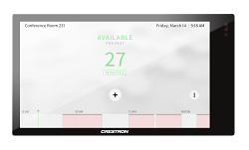
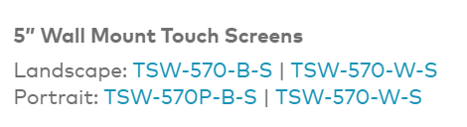

The 70 Series Line-up: Wall mount (TSW)
Enlarged display with thin bezels
  Programmable virtual buttons
  Proximity motion detection within 4’ range
  Dual USB for expanded functionality
  PoE+ powered
  5”, 7” & 10” in black & white color options
    Including 5” portrait
    Bluetooth and Wi-Fi available on 7” and 10”

Slide 13

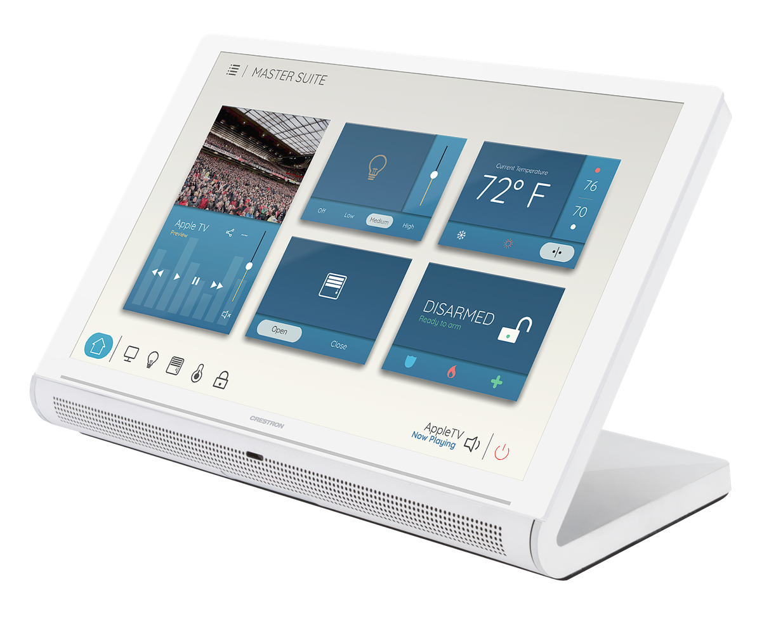
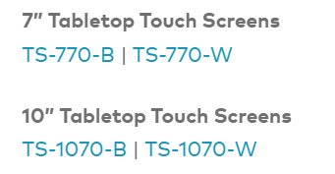
The 70 Series Line-up: Tabletop (TS)
All-in-one modern unified design
  Programmable virtual buttons
  Integrated mute indicator for UC usage
  Proximity sensor range up to ~12 feet
  Front facing speaker
  PoE+ powered
  7” & 10” in black & white color options
Proximity Sensor

Slide 14
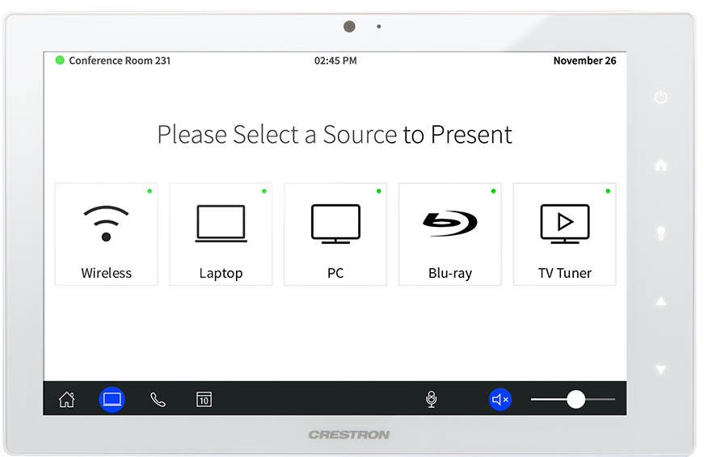
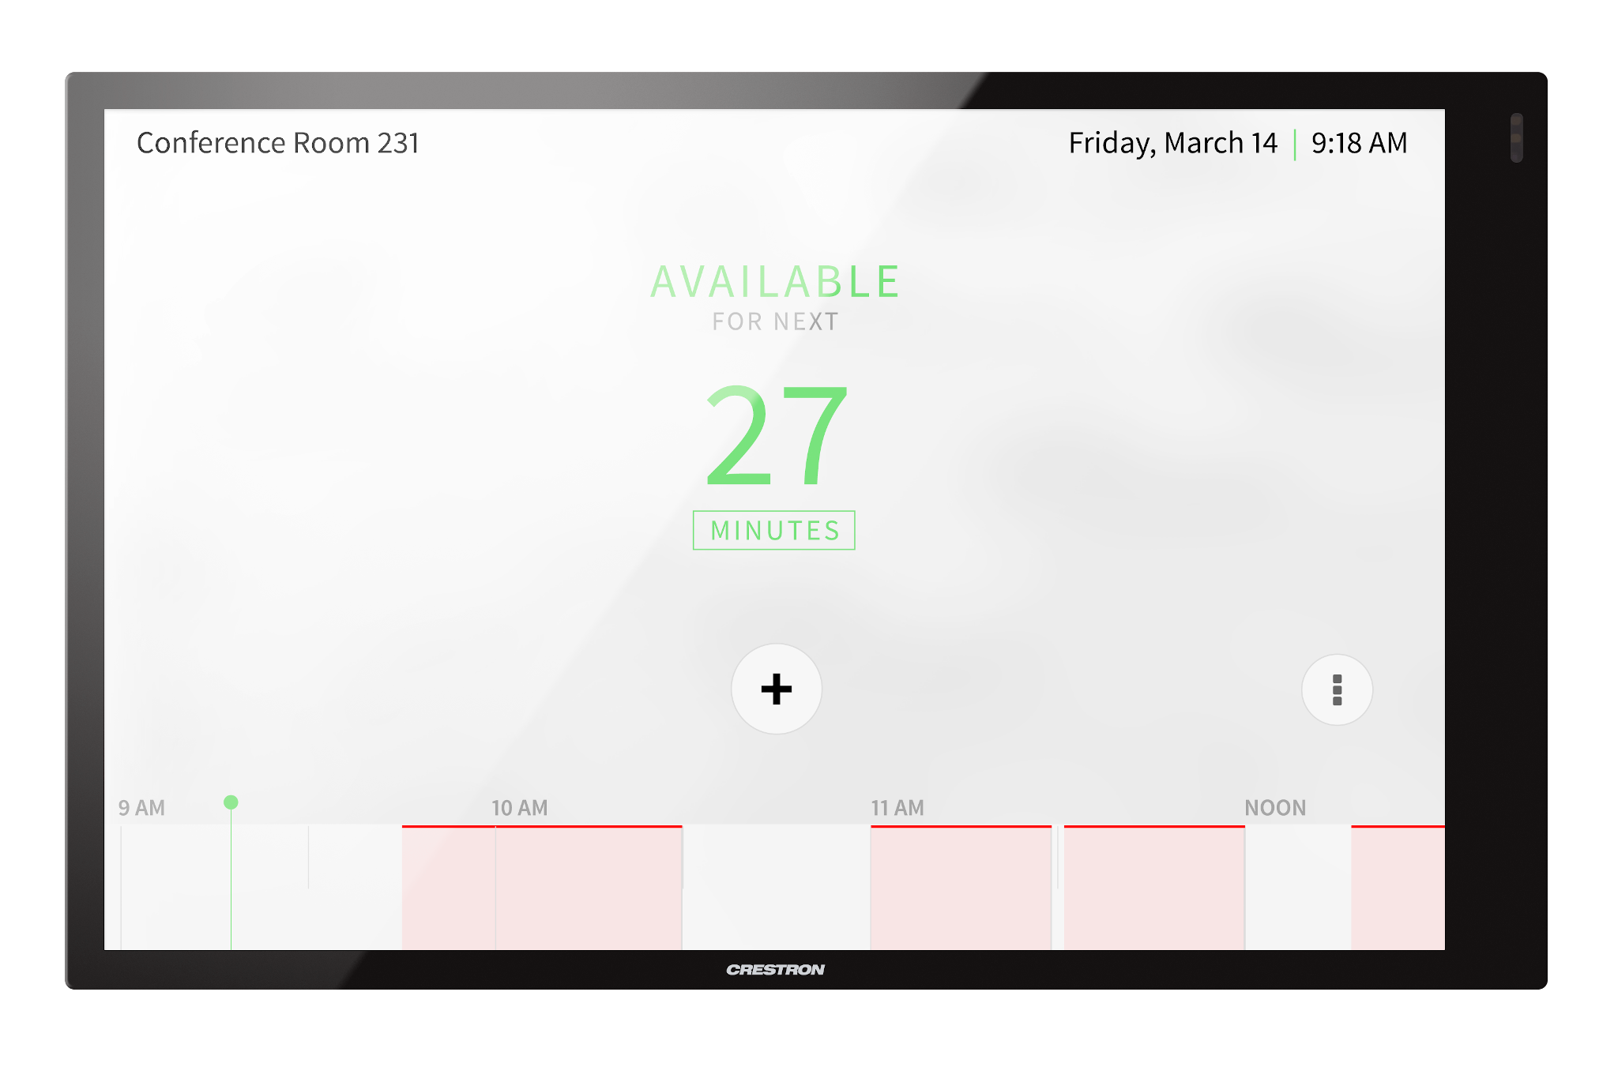
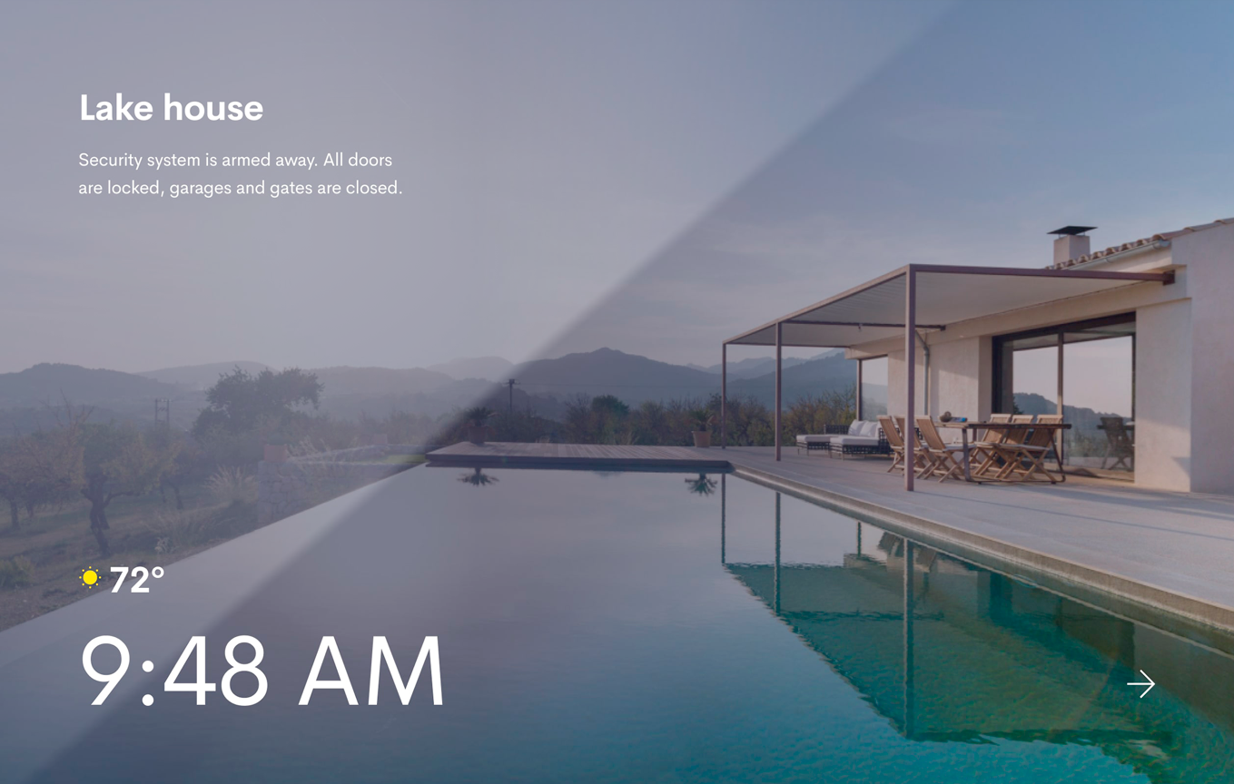
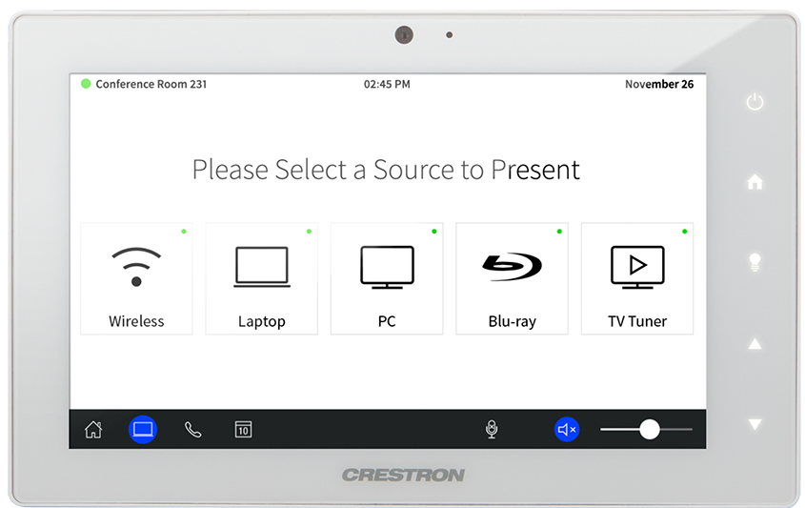
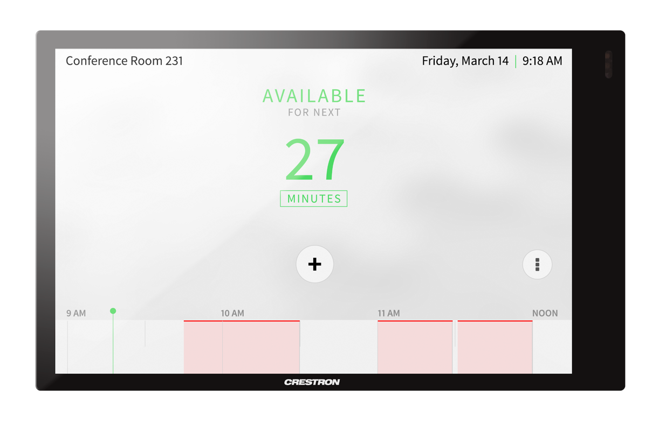

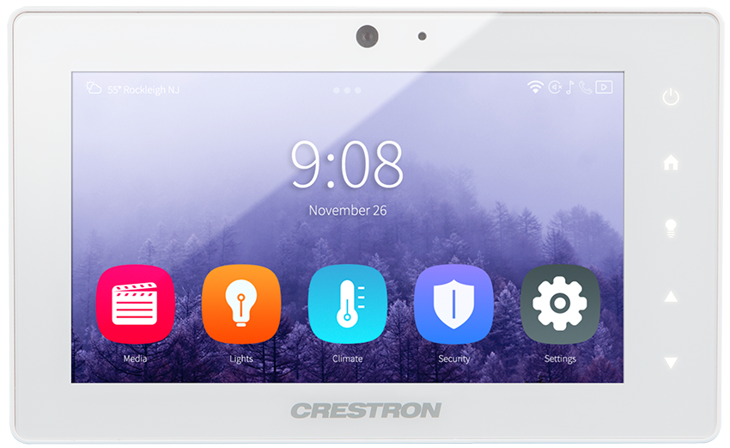

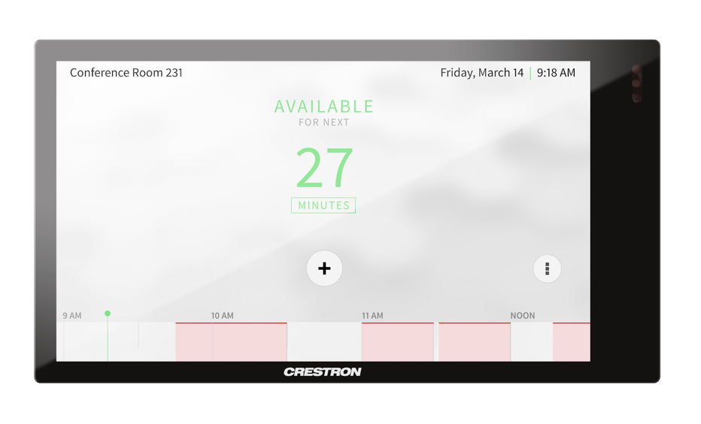


Compact and sleek design, ready to impress
Thin bezels reduce the overall dimensions and emphasize the screen for a sleek and compact look
Higher resolution display for sharper user interfaces and streaming video
Resolution | x50 & x52 | x60 | x70
5” | 800x480 | 960x540 | 1280x720
7” | 800x480 | 1024x600 | 1280x800
10” | 1280x800 | 1280x800 | 1920x1200
168 mm
10”, 60-Series
10”, 60-Series
149 mm
10”, 70-Series
10”, 70-Series
122 mm
7”, 60-Series
7”, 60-Series
106 mm
7”, 70-Series
7”, 70-Series
89 mm
125% more pixels
18% size reduction
5”, 60-Series
5”, 60-Series
Aspect Ratio | x50 & x52 | x60 | x70
5” | 15:9 | 16:9 | 16:9
7” | 15:9 | 17:10 | 16:10
10” | 16:10 | 16:10 | 16:10
72 mm
5”, 70-Series
66% more pixels
22% size reduction
5”, 70-Series
77% more pixels
27% size reduction
131 mm
173 mm
240 mm
145 mm
194 mm
260 mm

Slide 15
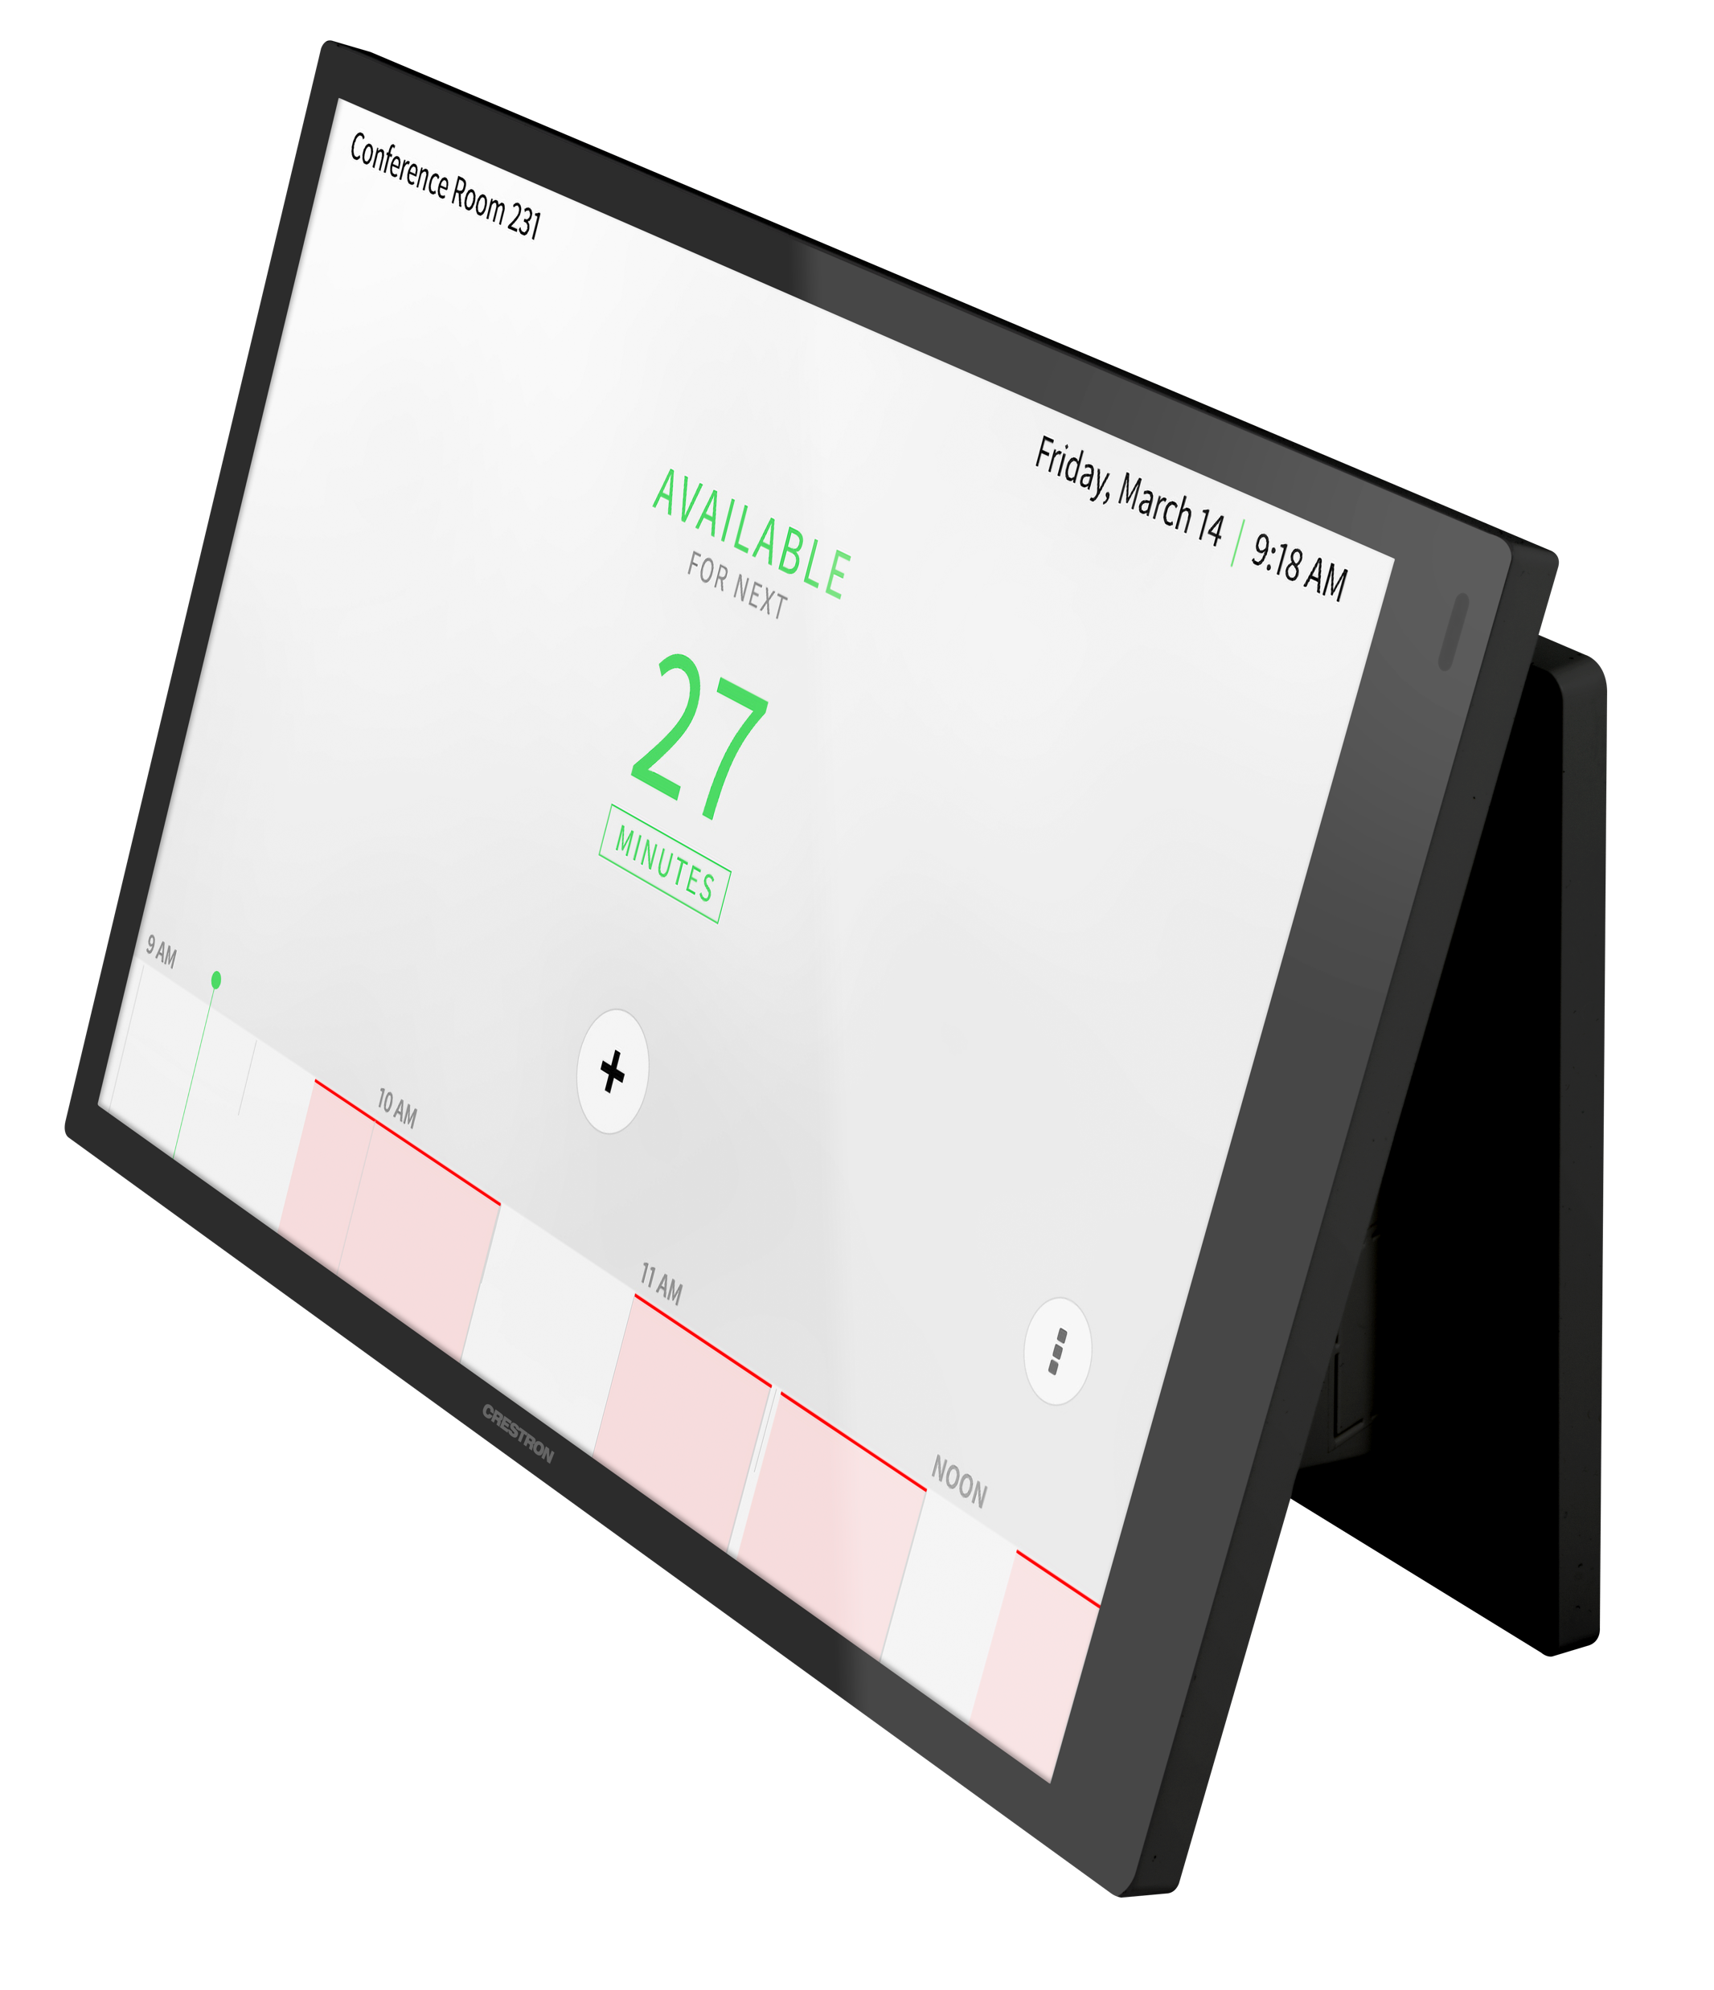
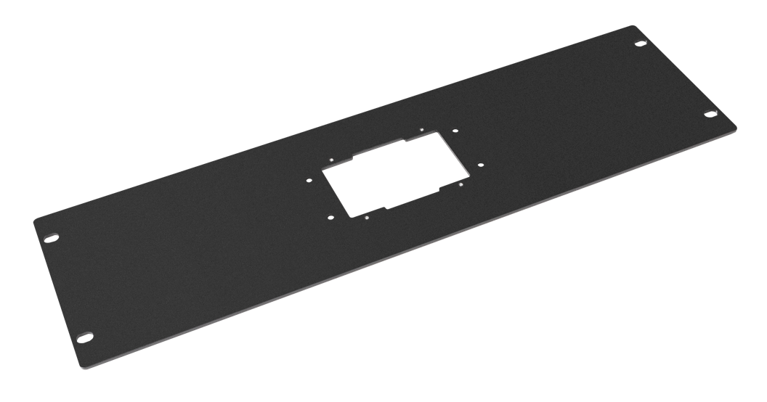
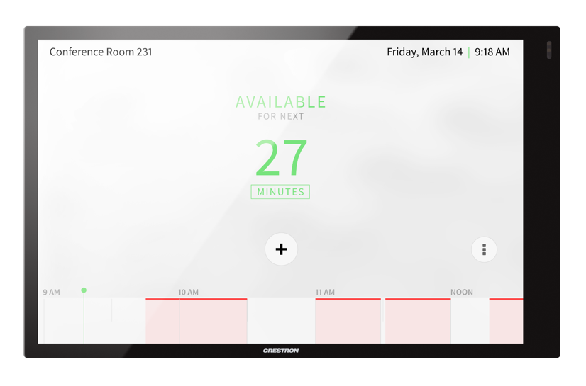
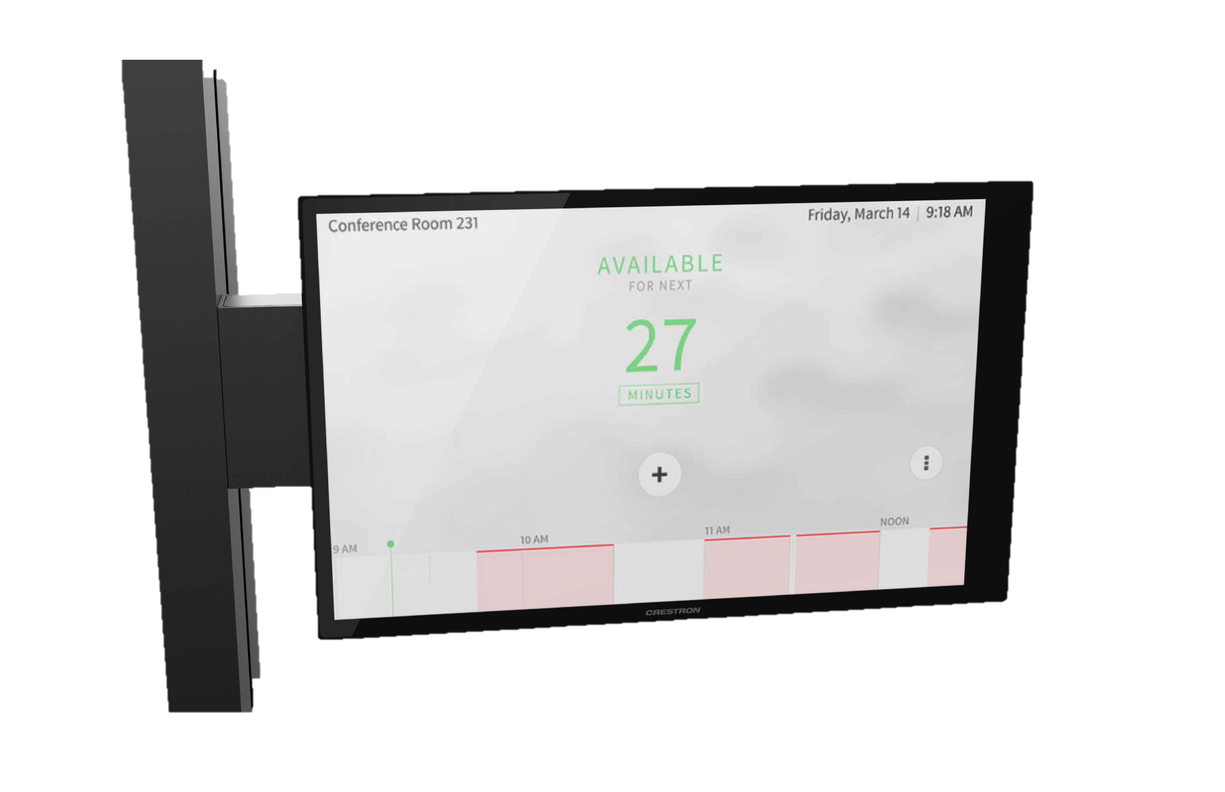
Accessories: Mounting Options
Meet any physical installation
Standard 2-gang
Mullion Mount
Multi-surface Mount
Rack Mount
For 5”, 7” and 10”
For 7” and 10”
For 7” and 10”
For 5”, 7” and 10”
(Default with each touch screen)

Slide 16
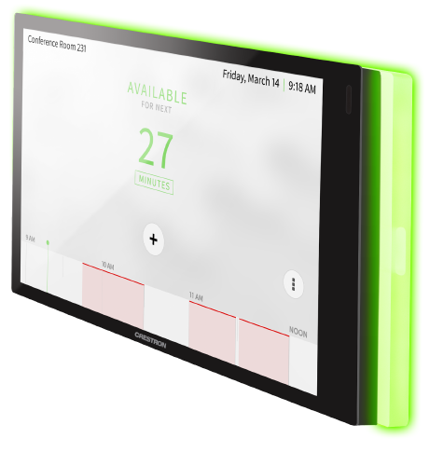
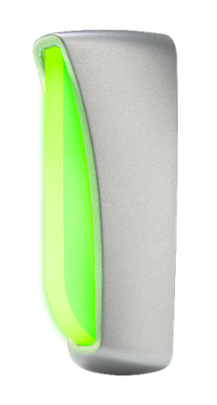
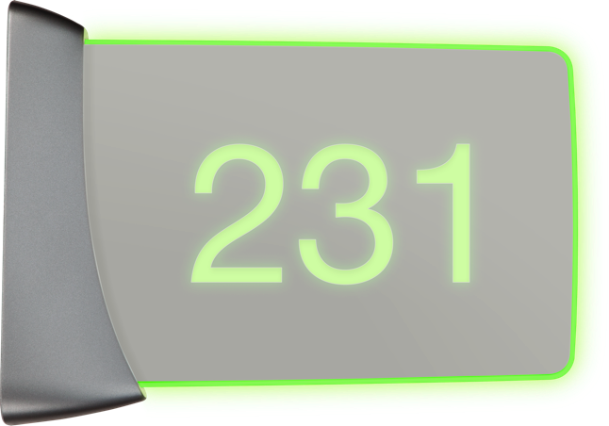
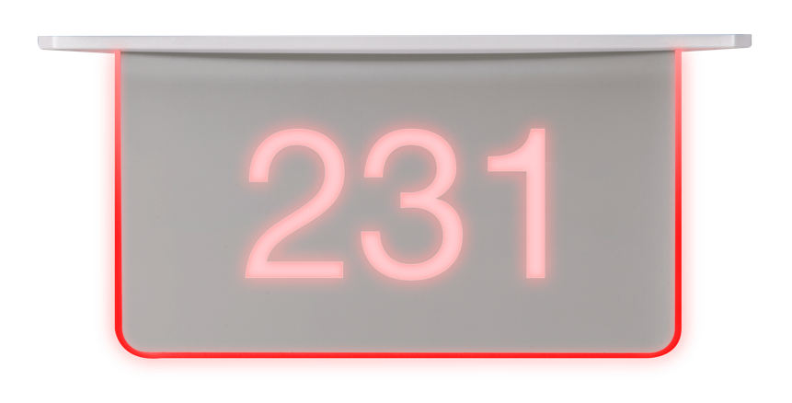
Accessories: Room Availability Indicators
Customizable room status indicators makes it easy to find rooms
  Connect via USB to any Crestron room scheduling touch screen
Light Bar
For 7” & 10”
Room Availability
Status Indicator
Room Availability
Hallway Sign
Room Availability
Hallway Sign
Touch screen mounted
Wall mounted
Wall mounted
Ceiling mounted

Slide 17
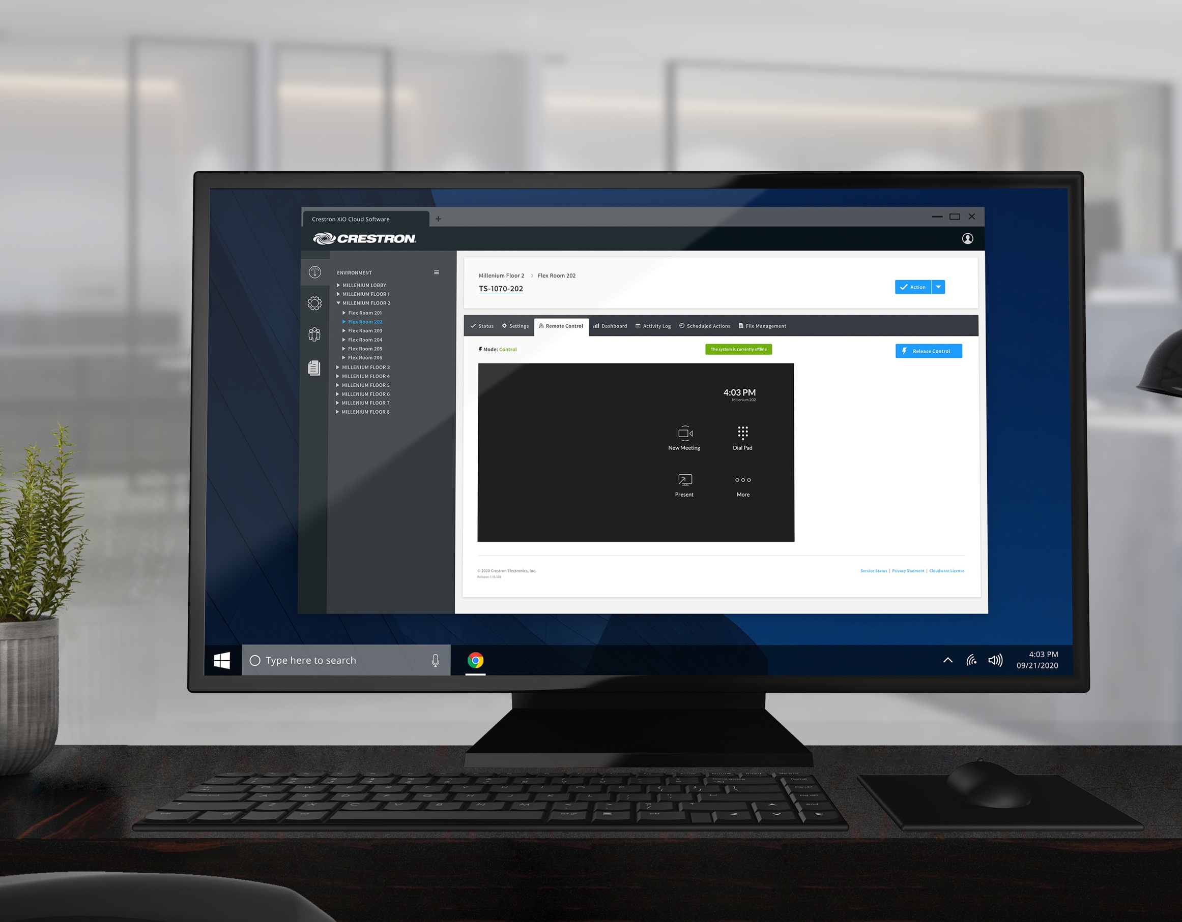

Touch Screen Deployment and Management – at scale
Crestron XiO Cloud® cloud-based management platform enables:
  Remote access and control of any touch screen
    White-glove support
    Anywhere around the world
  Mass deployment and management
    Settings configuration
    Device status
    Firmware and software updates
  Insight and analytics
    Device and room usage
    Support in technology planning and investment
Notes:
Slide is animated.
60 Series going limited supply on Nov. 1, 2020 and expect to runout by Dec. 31, 2020.
FAQ:
How do I convert my existing 60 series to 70 series?
We give you time to convert 60 Series going limited supply on 11/1, expect to runout by 12/31

Slide 18
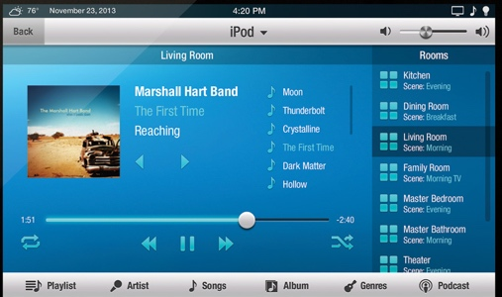

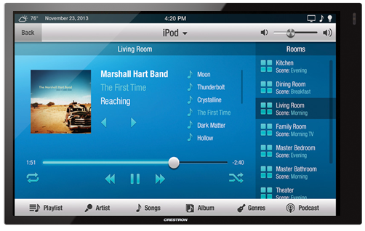
Upgrading to 70-Series is easy
50-Series
52-Series
60-Series
  As simple as switching from an older touch screen to the
  new 70-Series
  1. Swap the hardware:
    Pop out prior touch screen and mounting bracket and replace
    with 70-Series touch screen and mounting bracket
    7” Faceplate (paintable) sold separately (TSW-770-FP-W-S,
    TSW-770-FP-B-S), to cover oversized remodel gang boxes
  2. Re-use Smart Graphics user projects from 50-, 52-,
  and 60-Series
    Option 1:
      No recompiling necessary, use the compiled .VTZ project
      Convert Smart Graphics VTZ project using new “Smart Graphics VTZ Upgrade” function in Toolbox, then deploy to 70-Series
    Option 2:
      Standard procedure - update the source project, re-compile and deploy
Convert and Load Smart Graphics
.vtz using Toolbox

Slide 19
The Gateway to Experiences
Expand capabilities with integrated systems

Slide 20
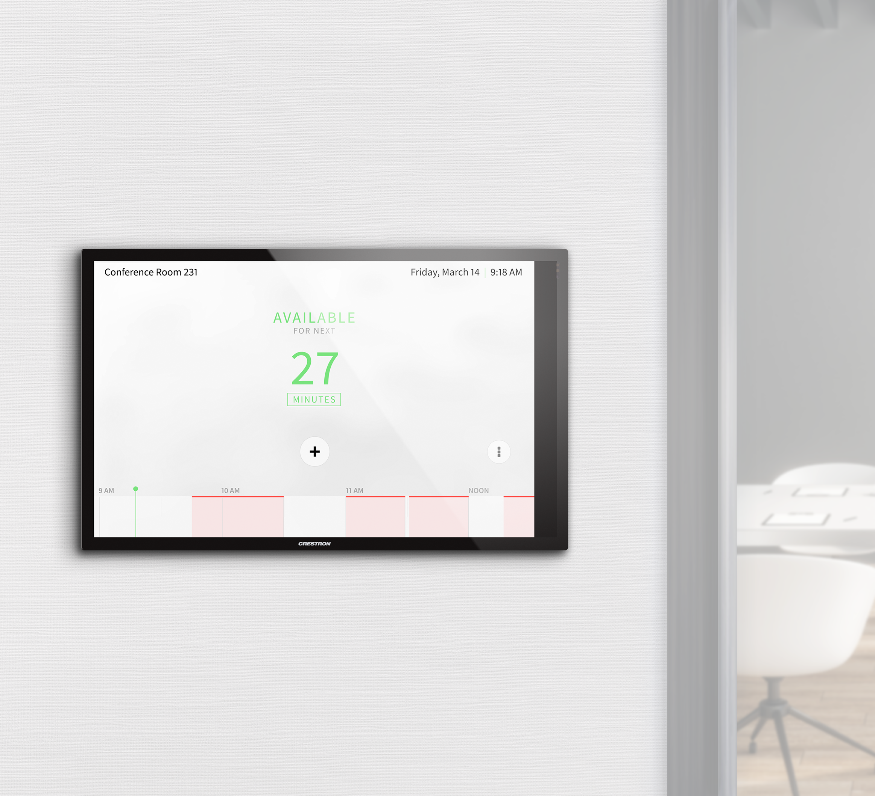
Crestron Room
Scheduling Solutions
A complete platform. A total solution.
  Find and book a space
    On an app, from a desk, or on the spot
  Choose your application
    15+ scheduling partners
    Direct connect and native experiences
  Deploy, monitor and maintain remotely
  Gather intelligence, manage resources,
  and reallocate spaces
Learn more crestron.com/scheduling

Slide 21
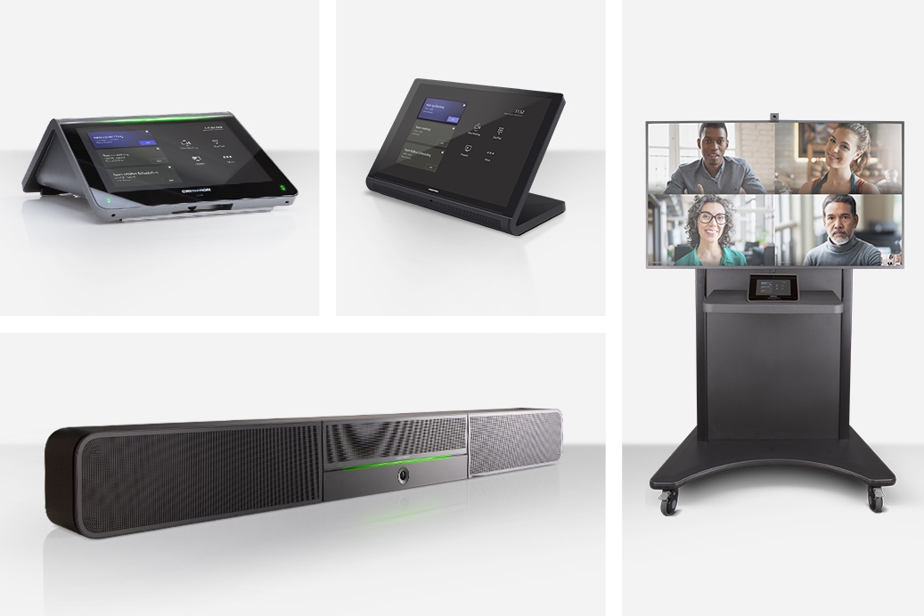
Crestron Flex UC Solutions
    Have more options, opportunities and
    possibilities to communicate, collaborate
    and control from anywhere
    One consistent experience
      Deliver flawless video, crystal clear audio,
      and instant sharing
    One-touch simplicity
      Any room, anywhere, every presentation is
      just one click away
    One platform
      An entire product line up to suite any space
      from small to custom conferencing spaces
      Tabletop, speaker bar, and custom integration
Learn more crestron.com/flex

Slide 22
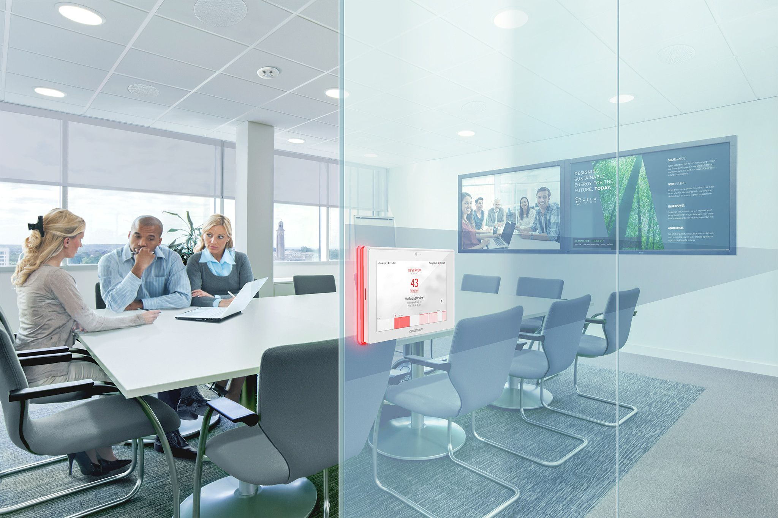

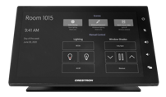

Crestron 4-Series™ Control Systems
Unify technologies and expand functionality
  Control every aspect
    AV, voice + data, streaming media, lights,
    shades, security, and HVAC
  Scalable for any size application
    Small, medium, large
    Build to campus
  One secure, manageable software-based platform
    Hardware or virtual control solutions
    Enterprise-grade security
    Simple and convenient deployment and management
Lights
Audio
Video Source
Shades
Display
Microphone and Cables
Learn more crestron.com/controlsystems

Slide 23
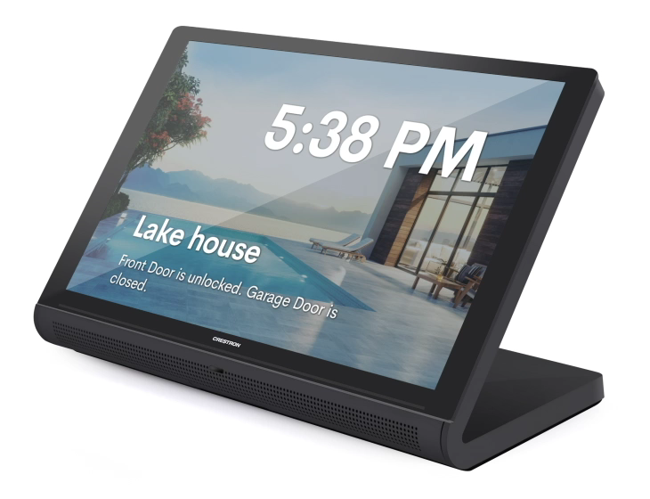
Crestron Home™ Solutions
Elevate the living experience –
transform everyday commands
into instantaneous delight
  Control every aspect of the home
    Security, lighting, shades, climate, pool and
    pool space, rooms, audio, and video
  One experience across any device
    Smart phone or tablet
    Crestron touch screen
Learn more crestron.com/home

Slide 24
Crestron 70 Series Touch Screens
Learn more at crestron.com/touchscreens

