Slide 2
Crestron FT2 FlipTops™ ^{Cable management systems}

Slide 3

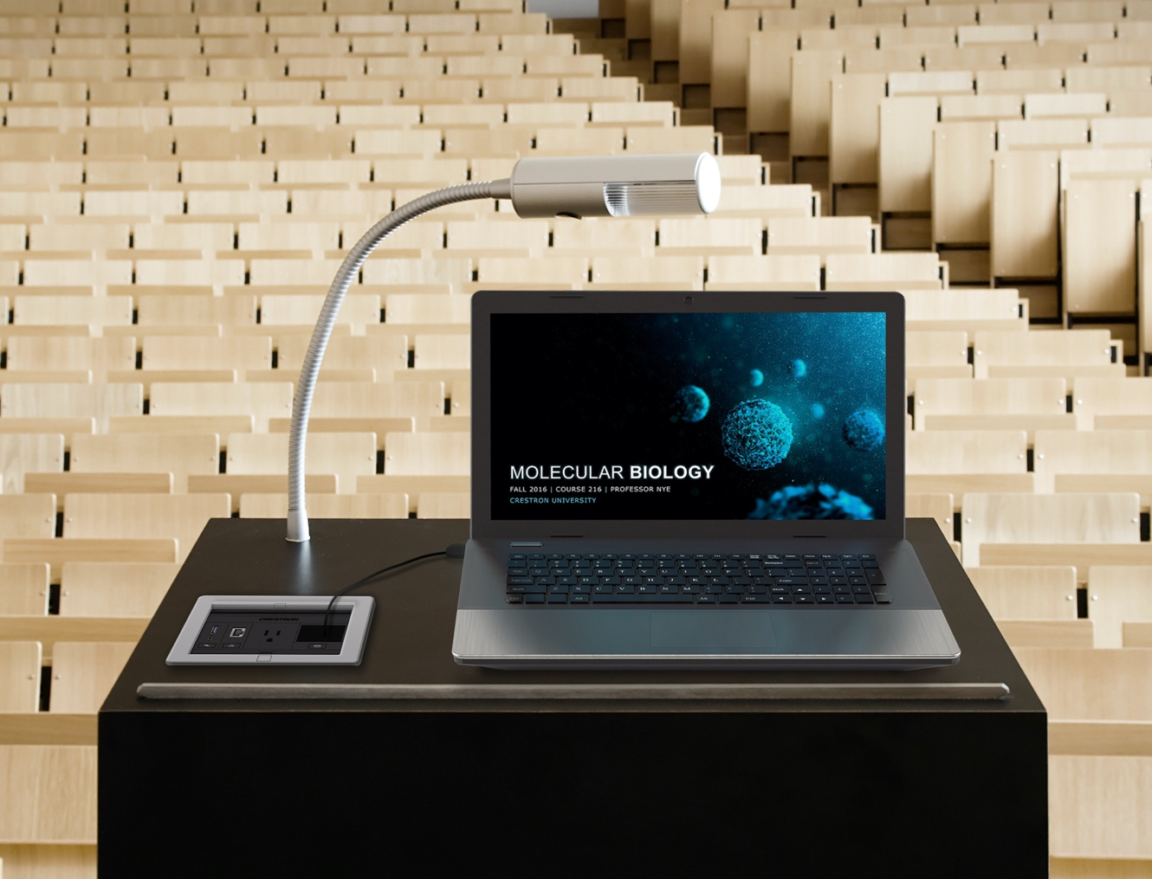
Bring clean, convenient connectivity to the table
Conference rooms
Lecterns

Slide 4
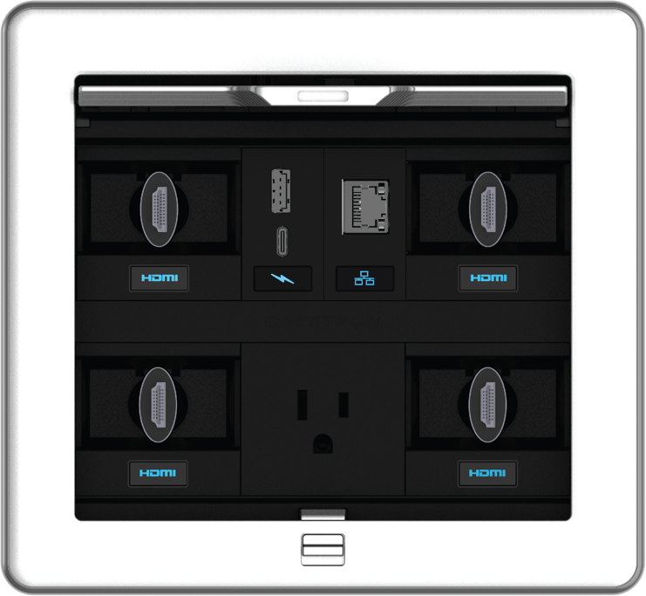
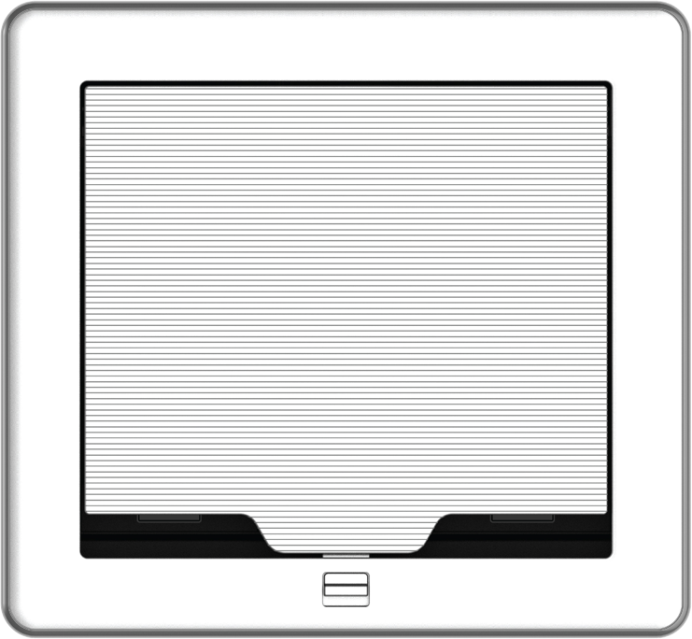
Clean, convenient connectivity
All connections and cables concealed inside beautiful drop-in industrial designs
No visible gaps or screws
High-quality finishes complement any décor
Pass-through lid allows cables to be fully extended while lid is closed, leaving surfaces and views unobstructed
Highly modular design – can easily be configured and updated to meet the specific needs of any meeting space
Fits industry standard size cutouts
Dashboard-forward design: No more reaching into a dark hole

Slide 5
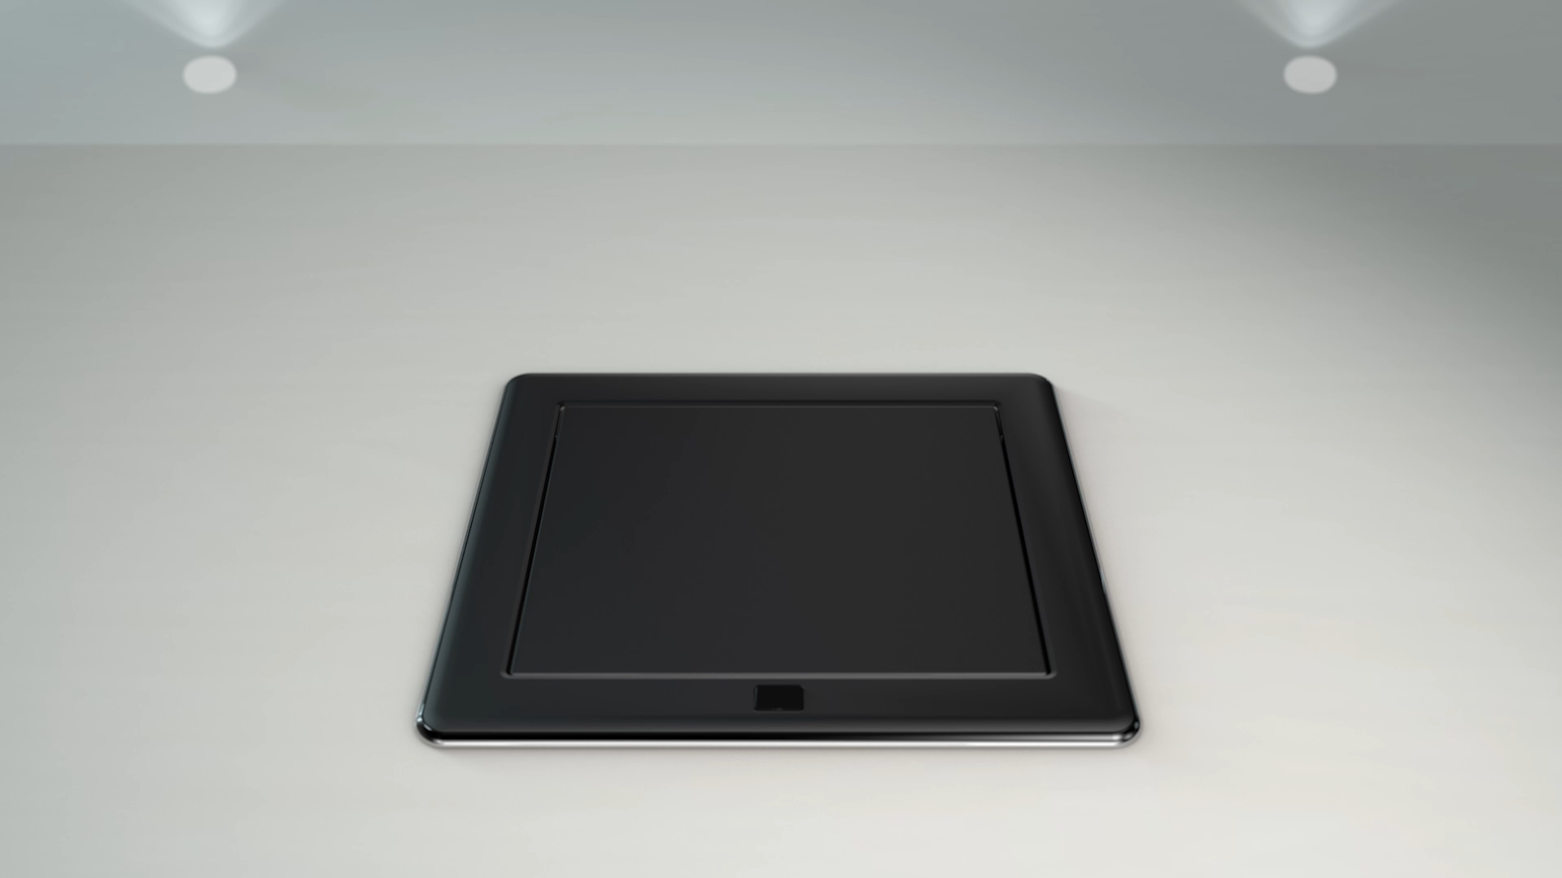
One-touch pass-through lid delights end users

Slide 6
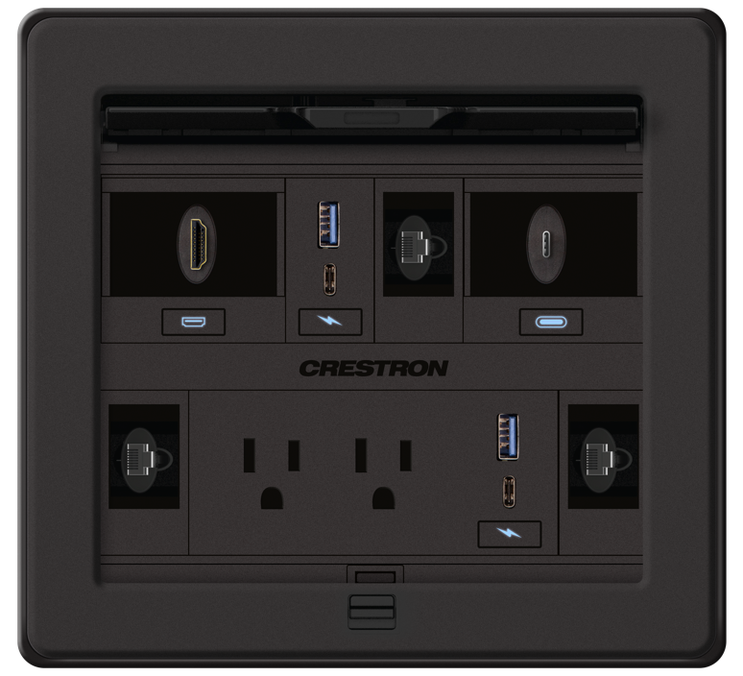
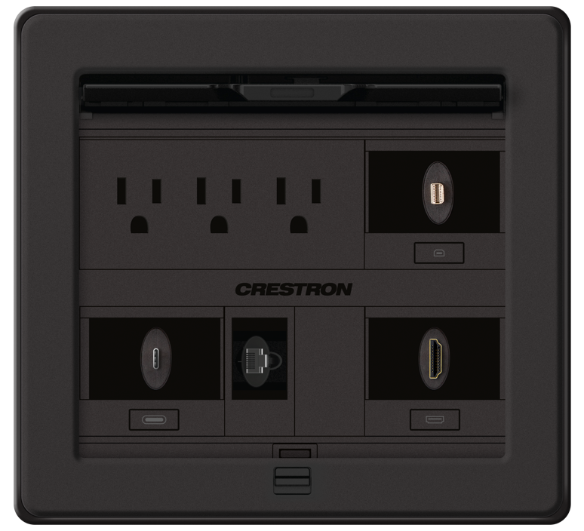
Two versions: Active or Passive
Active FlipTop
Passive FlipTop
Supports USB-C™ charging modules, one-touch or vertical gravity retractors, pass-through lid, and all active 4K connector plates. All labels are backlit.
Supports AC power, basic pass-through cables, pass-through lid, flush-mount connectors in keystone plates, and gravity retractors with precision track and pulley mechanism.

Slide 7
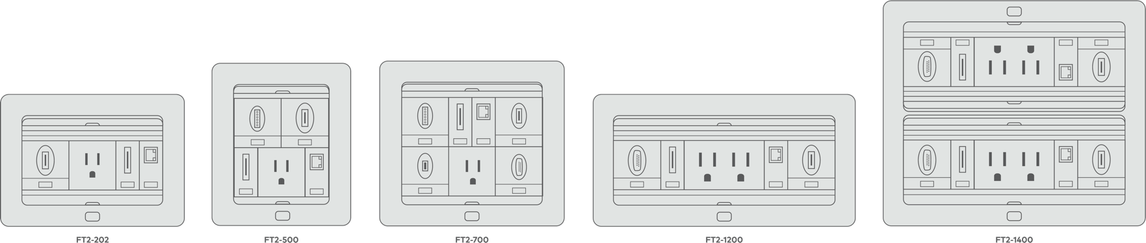
A variety of sizes for any installation
FT-202
(7” W x 3.25” D)
FT-500
(5.75” W x 5.75” D)
FT-700
(7.125” W x 5.75” D)
FT-1200
(10” W x 4” D)
FT-1400
(10” W x 6.75” D)
*cutout sizes shown

Slide 8
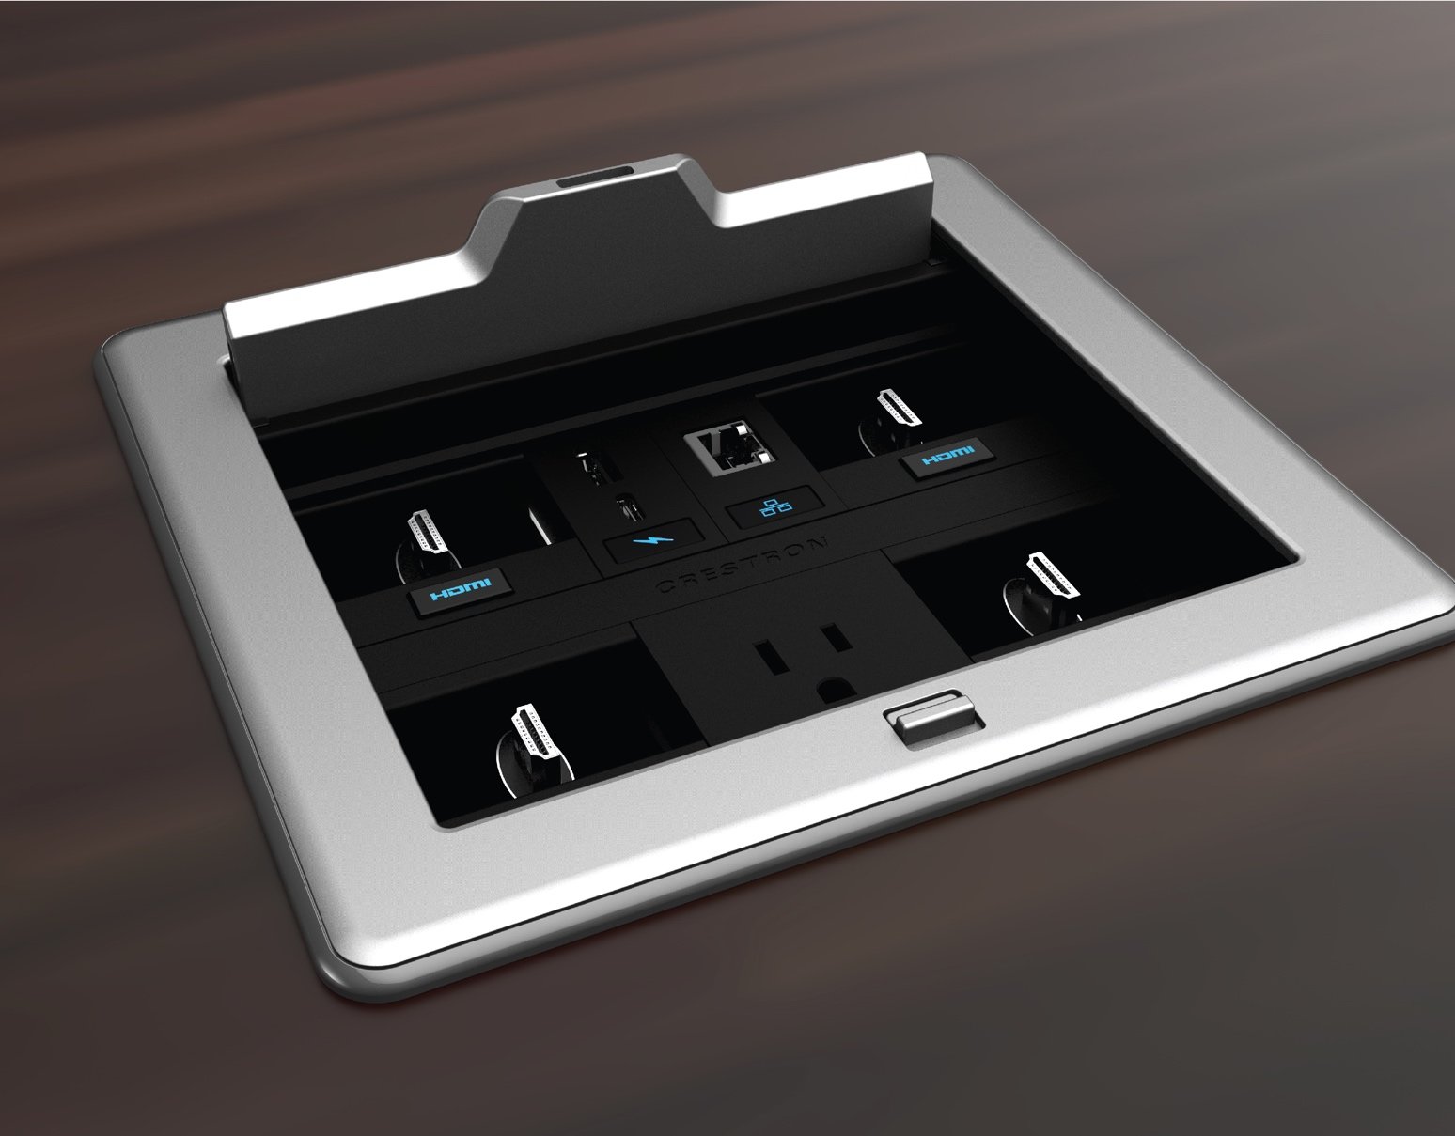
Choose the right cables and connections
From USB charging to HDMI® and DisplayPort connectivity and more, FT2 FlipTops offer the connections you need.

Slide 9
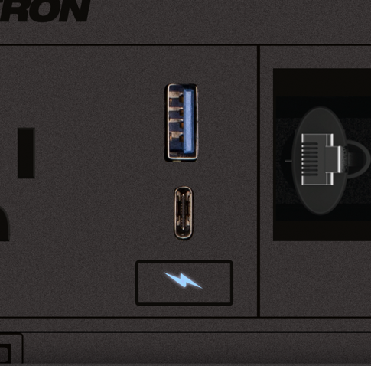
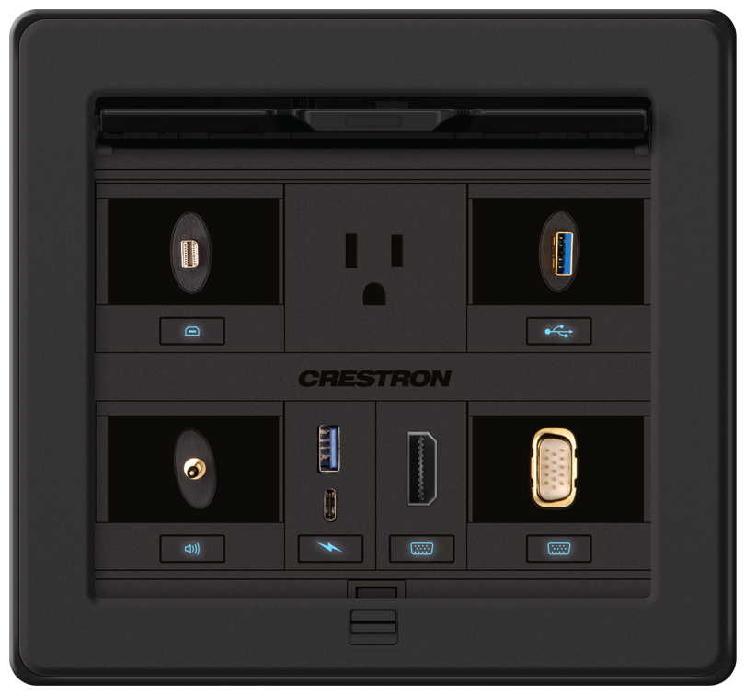
USB-A and USB-C charging
Provides one USB Type-C charging port and one USB Type-A charging port
Can be used simultaneously to quickly charge devices
Active only
Requires one slot (one per row)

Slide 10
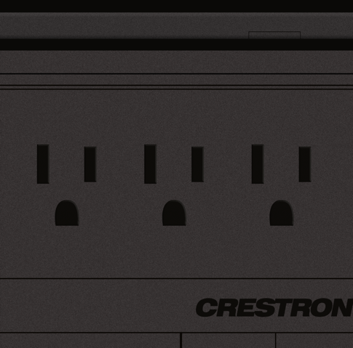
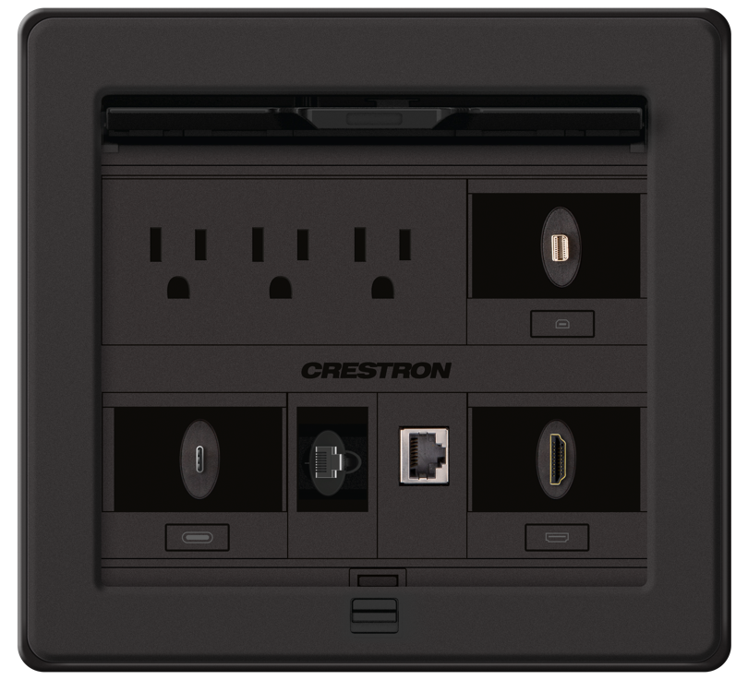
U.S. power modules
Provides one, two or three power outlets at the surface of the FlipTop
Active and Passive
Requires two, three, or four slots

Slide 11
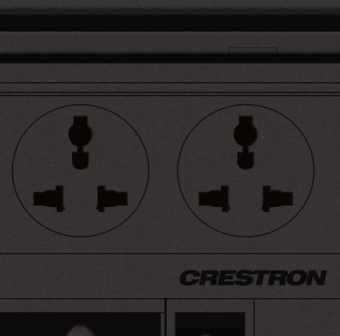
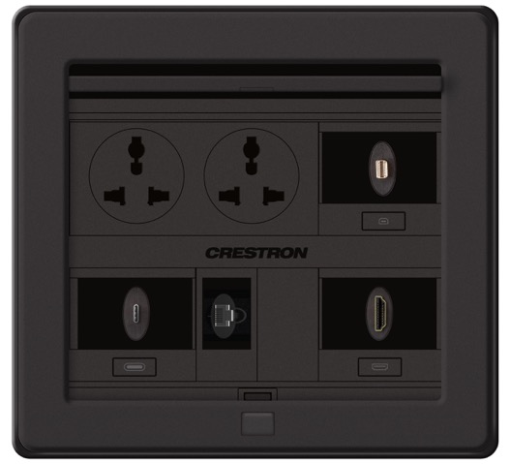
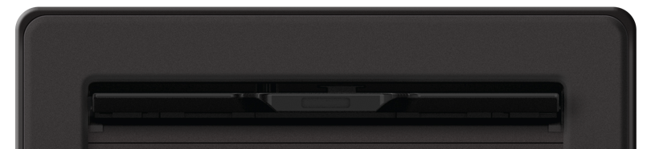

International power modules
Provides one or two power outlets at the surface of the FlipTop
Active and Passive
Requires two, three, or four slots
Available for: Australia /NZ/China, European Schuko, France/Belgium, Israel, Italy, Switzerland, UK, Universal

Slide 12
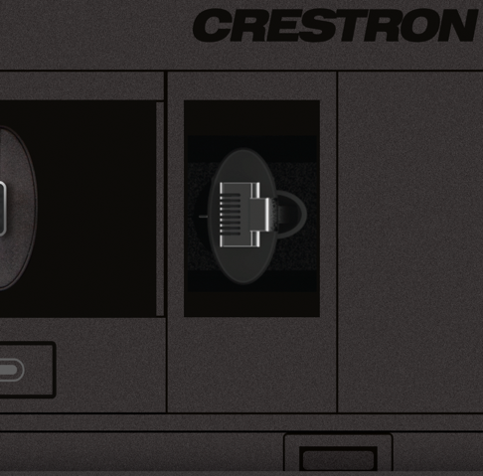
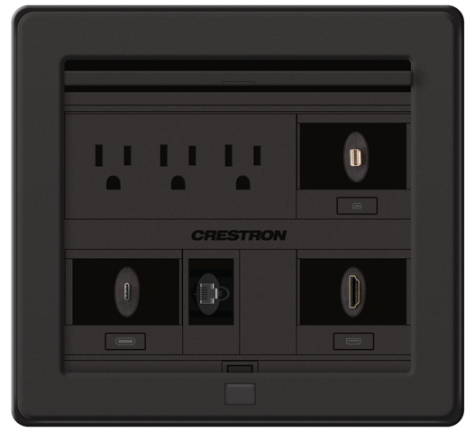
Pass-through cables
High-performance, purpose-built interface cable
Active and Passive
One slot per cable
Options: HDMI, CAT6, USB, 1/8” audio, VGA, USB-C to HDMI, DisplayPort, DisplayPort to HDMI, Mini DisplayPort to HDMI, Mini DisplayPort to DisplayPort

Slide 13
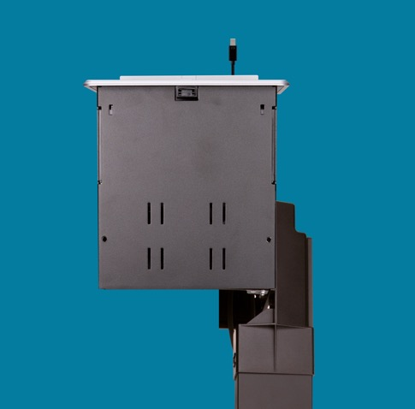
Gravity retractors
Gravity-assisted track and pulley mechanism
Up to 3' of cable
Retract gently by lifting the cable vertically above the FlipTop
Installs in any corner of a FT2 FlipTop
Field replaceable cable included
Active and Passive
Requires two slots
Extends 28.11" vertically down from the top of the table

Slide 14
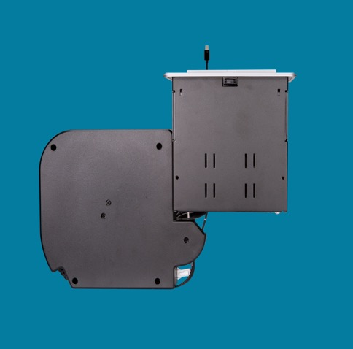
One-touch retractors
Electrically clutched, spring powered retractors that reels in cables with a touch of the backlit button
8" diameter under the table enclosure allows 4' of cable to be extended easily
Active only
Requires two slots
Extends 11.58" vertically from the top of the table
Automatic retraction with control system
Additional room functionality when connected to control system

Slide 15
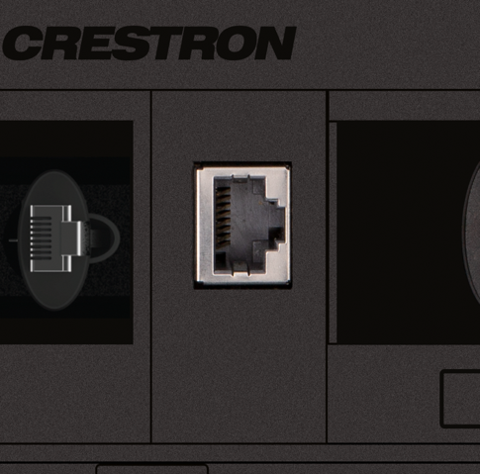
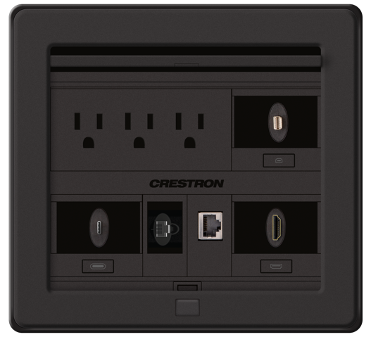
Keystone connector plates
Enables installation of standard flush-mount keystone connectors
Cannot pass 4K60 4:4:4
Active and Passive

Slide 16
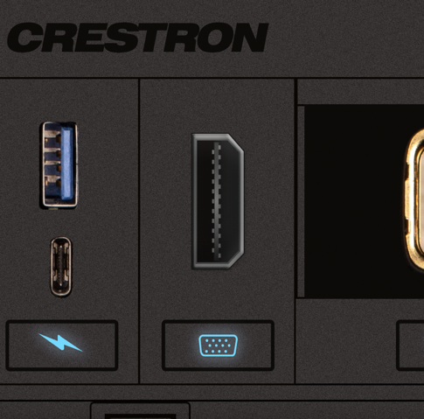
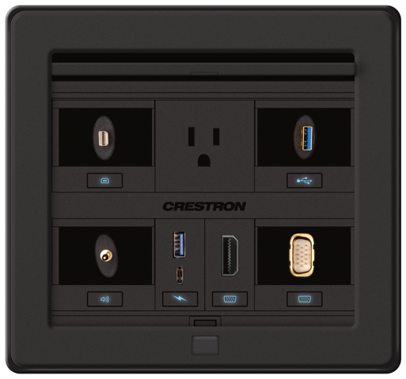
Active connector plates
Panel-mount interface solution, labeled with a backlit international symbol for connection type
Preserves 4K60 4:4:4
Active only

Slide 17
Choose your accessories
Shelves, shrouds, and mounts
Cables
Power supplies
Automated functionality
Connect Active FlipTops to a Crestron control system or DMPS to provide additional room functions, including
Actions trigged by occupancy and/or scheduling events
Coordinated cable retraction
After each meeting
End of the day

Slide 18
Design your own at crestron.com/FlipTops

